Slide 1

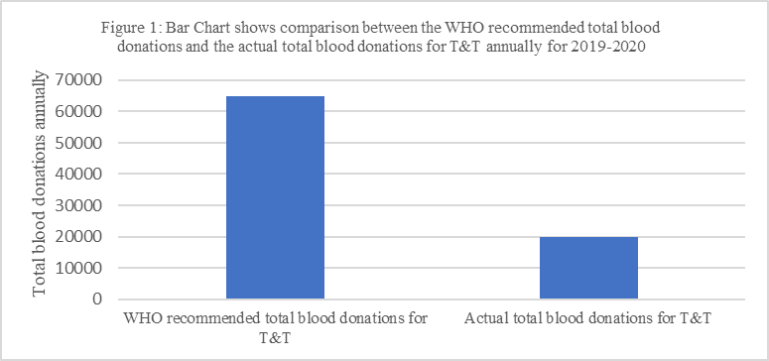
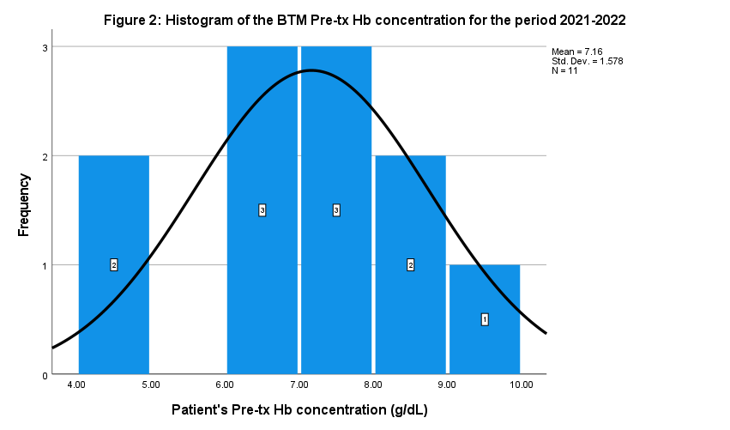
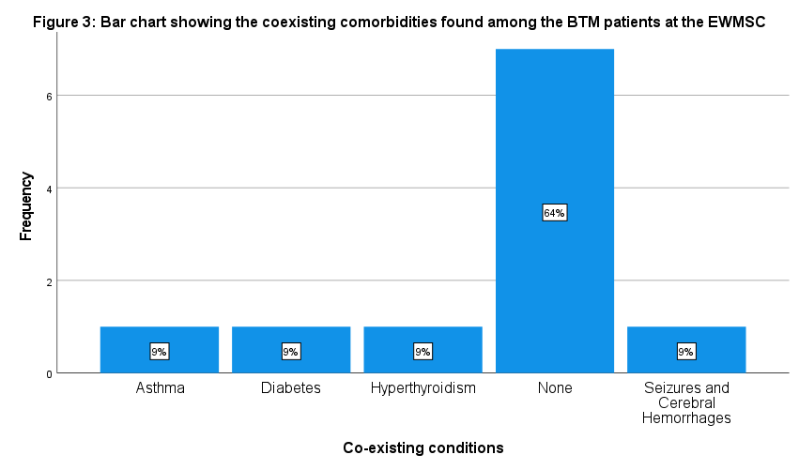
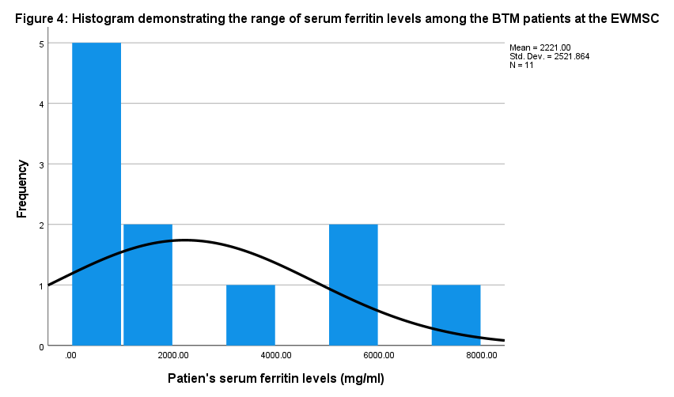
The Burden of Beta Thalassemia Major on Blood Banks at a Tertiary Institution in Trinidad and Tobago
Your
Group
LOGO
Jethora Bailey, Josiann Baker-Rosaria, Saschim Balkaran, Navita Balkissoon, Cherisse Bando, Ariana Baptiste, Marie-Clarie Barcant, Miguel Basdeo,
Dr. Kenneth Charles.
¹Department of Paraclinical Science, Faculty of Medical Sciences, The UWI
e: navita.balkissoon@my.uwi.edu kenneth.charles@sta.uwi.edu
Introduction
Results
Discussion
Beta Thalassemia Major (BTM) is a rare, life-threatening blood disease requiring frequent blood transfusions for survival. Affecting 1.5% of people worldwide, and approximately 0.0053% of Trinidad and Tobago’s (T&T) population.
According to the ministry of health, a total of 20,000 units of blood are donated via Trinidad and Tobago’s 6 blood donation centres which is alarmingly low when compared to the World Health Organization‘s recommendation of 65,000 units for T&T’s population. Furthermore, >80% of these donations are replacements rather than voluntary non-remunerated ones. These statistics coupled with the fact that BTM patients need transfusions every 2-4 weeks gives a clear picture of the burden of the disease.
11 BTM adult patients at the EWMSC received 2 units per month from the period 2016 - 2021 for their survival.
With adequate blood transfusions, the complications which most of the patients experienced associated with BTM can be avoided.
Being of East Indian (81.2%) and mixed (18.2%) ethnicity may have predisposed them to inheriting BTM while age, residence and gender had no role.
Screening for BTM trait can help monitor, trace and reduce BTM’s prevalence.
Pre-tx Hb was found on average to be 7.16 g/dL (normal ⩾ 9 g/dL) which highlights the under-transfusions of these patients leading to abnormalities associated with this chronic anaemia.
Bone marrow transplantation has proven to be the only cure for BTM, however, due to lack of knowledge and availability of bone marrow donors, blood transfusions and iron chelation therapy (ICT) have become the primary forms of treatment in T&T.
Serum ferritin levels were significantly elevated despite ICT which contributed to iron overload seen in BTM.
Under-transfusion and iron overload have persisted within these patients which calls for new, efficacious treatments to reduce blood transfusions.
Objectives
To assess the fraction of the blood donated that is allocated to the beta thalassemia major patients on Blood bank at the Eric Williams Medical Sciences Complex.
To assess the adequacy and management of blood donation in Eric Williams Medical Science Complex.
Conclusion
Methodology
BTM patients require regular adequate blood transfusions in order to survive and have a good quality of life. This reality also bleeds an already deprived blood bank at the EWMSC. Therefore, the lack of blood donations is one of the major contributing factors for the various health disorders experienced by BTM patients. The growing need for voluntary non-remunerated blood donors continues to be the major aim of the blood bank system of T&T in order to help alleviate this burden.
Clinical audit conducted at EWMSC from May 11th-26th 2022
Questionnaires with information sourced from the EWMSC records from the medical records of 11 BTM patients (period Jan 2016 - Dec 2021)
Study population - all BTM patients in T&T
Study sample - all BTM patients who are treated at EWMSC
Inclusion criteria - Adult patients diagnosed with BTM at EWMSC.
Exclusion criteria - Patients diagnosed with Beta Thalassemia Minor and Intermedia at EWMSC.
Ethical consideration - UWI/NCRHA approval.
Statistical Analysis - Social Sciences (SPSS) software for data analysis. Evaluated using Chi-square analysis and logistic regression
References
Shah FT, Sayani F, Trompeter S, Drasar E, Piga A. Challenges of blood transfusions in β-thalassemia. Blood Rev [Internet]. 2019 [cited 2021 Oct 11];37(100588):100588. Available from: https://pubmed.ncbi.nlm.nih.gov/31324412/
WHO. Voluntary unpaid blood donations must increase rapidly to meet 2020 goal [Internet]. Who.int.[cited 2021 Oct 13]. Available from: https://www.who.int/news/item/13-06-2016-voluntary-unpaid-blood-donations-must-increase-rapidly-tomeet-2020-goal
Arian M, Mirmohammadkhani M, Ghorbani R, Soleimani M. Health-related quality of life (HRQoL) in beta-thalassemia major (β-TM) patients assessed by 36-item short form health survey (SF-36): a meta-analysis. Qual Life Res [Internet]. 2019;28(2):321–34. Available from: http://dx.doi.org/10.1007/s11136-018-1986-1
NOTEWORTHY FINDINGS
27.27% reported having skeletal abnormalities
63.3% of patients have splenomegaly and 45.5% had a splenectomy
All the patients had high serum ferritin levels
90.9% of patients had low pre-treatment Hb concentrations
Acknowledgments
The group is eternally thankful to Dr. Kenneth Charles, Principal investigator and Ms. Marsha Ivey, Public Health instructor, for their continued guidance throughout this project. We also thank Dr. Rykel Rojas for her assistance with data collection.

