Slide 1


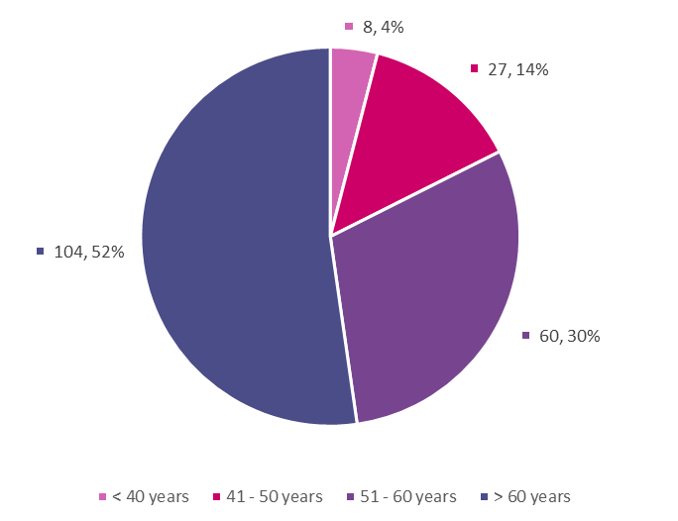
The effectiveness of Telemedicine on the Management of Chronic Diseases (Diabetes, Hypertension and Coronary Heart Disease) at ERHA Primary Health Care Facilities during the COVID-19 pandemic
Jessie Gopaulsingh, Zada Gopee, Roneice Gould, Anique Gray, Kishan Harripersad, Rachael Harripersad, Nalini Heeralal, Dr. Raveed Khan
¹Department of Para Clinical Sciences, Unit of Public Health & Primary Care, The University of the West Indies, St Augustine
e: jessie.gopaulsingh@my.uwi.edu Raveed.Khan@sta.uwi.edu
INTRODUCTION
RESULTS
DISCUSSION
During the COVID-19 pandemic, Trinidad and Tobago’s Government implemented lockdowns and limited outpatient clinics to curb virus transmission. For those with comorbidities (eg.DM, HTN, heart conditions), the risk of severe illness and fatality is increased¹. Hence, a niche for telemedicine developed to address infection control and the continuity of care of chronic disease patients.
At the ERHA, a Telemedicine initiative was introduced at primary health centres in late 2020. Hence,our group decided to perform a comparative 6 month study to analyse chronic disease outcomes and to assess the effectiveness of telemedicine.
Figure 1: Age range of patients at Health Centres (Cumuto, Coryal and Valencia) in Telemedicine Study.
More females than males were enrolled in the telemedicine program, with patients over 60 representing more than half of the study population. This finding contrasted with other studies, where younger patients were more likely to enrol in Telemedicine than older patients³.
RBS, BP and weight showed no statistical significance suggesting that the standard of care was upheld both before and during telemedicine. A greater compliance was noted before telemedicine. During telemedicine, the number of compliant patients decreased.
CONCLUSION
OBJECTIVES
Table 1: Association between parameters before and during telemedicine
The clinical outcomes for patients accessing Telemedicine services for the management of CDs at these ERHA Health Care Facilities remain similar to those existing before Telemedicine’s introduction.
This non-inferiority in outcomes supports the continued use of telemedicine to better determine its long-term effectiveness and define its continued use in providing primary medical management.
Further studies should be done to assess the effectiveness of Telemedicine in Trinidad and Tobago.
Compare the effectiveness of telemedicine in treating patients with chronic diseases with face-to-face patient care.
Describe the characteristics (weight, BP, RBS and age) of telemedicine patients at ERHA primary health care facilities.
Parameters | P values
Random Blood Sugar | 0.355
Systolic Blood Pressure | 0.239
Diastolic Blood Pressure | 0.232
Weight | 0.621
METHODOLOGY
Wilcoxon signed rank test showed that a 6-month Telemedicine consultation did not elicit a statistically significant change in RBS, BP and Weight.
Study Design — An observational study design was utilised to investigate the effectiveness of telemedicine in the management of chronic diseases².
Data Collection — Data collection sheet was utilised where RBS, BP, weight and age were recorded.
REFERENCES
Associations.
Association between Compliance with medication and Blood pressure before telemedicine
Chi square showed significant association between compliance and blood pressure before telemedicine,
p = 0.001.
Risk estimate between compliance with medication and Blood pressure before telemedicine
Odds ratio showed that individuals who were compliant were 14.343 times more likely to have a non-elevated BP in comparison to an individual who is non-compliant.
Data Analysis — IBM SPSS Statistics 28.0: to generate Wilcoxon sign-rank test and inferential statistics.
Microsoft Excel: to generate graphs.
CDC. (2022, May 2). People with Certain Medical Conditions. Centers for Disease Control and Prevention. https://www.cdc.gov/coronavirus/2019-ncov/need-extra-precautions/people-with-medical-conditions.html
Orozco-Beltran, D., Sánchez-Molla, M., Sanchez, J. J., Mira, J. J., & ValCrònic Research Group. (2017). Telemedicine in Primary Care for Patients With Chronic Conditions: The ValCrònic Quasi-Experimental Study. Journal of Medical Internet Research, 19(12), e400. https://doi.org/10.2196/jmir.7677
Reed, M. E., Huang, J., Graetz, I., Lee, C., Muelly, E., Kennedy, C., & Kim, E. (2020). Patient Characteristics Associated With Choosing a Telemedicine Visit vs Office Visit With the Same Primary Care Clinicians. JAMA Network Open, 3(6), e205873. https://doi.org/10.1001/jamanetworkopen.2020.5873
Study Population — Telemedicine patients at the ERHA health facilities, inclusive of patients seen:
face-to-face before telemedicine (October 2019 to February 2020)
and during telemedicine (March 2020 to September 2020)
Non-telemedicine patients were excluded.
Data Protection — Patient information remained anonymous. Information collected were password protected and only accessible by the investigators
Sample Size — 278 patients were calculated. 199 from the ERHA fit the inclusion and exclusion criteria
ACKNOWLEDGEMENTS
We’d like to acknowledge Mr. Akini James and our statistician Mr. Rameez Baksh, for the guidance and for assisting us in this study.

