Slide 1

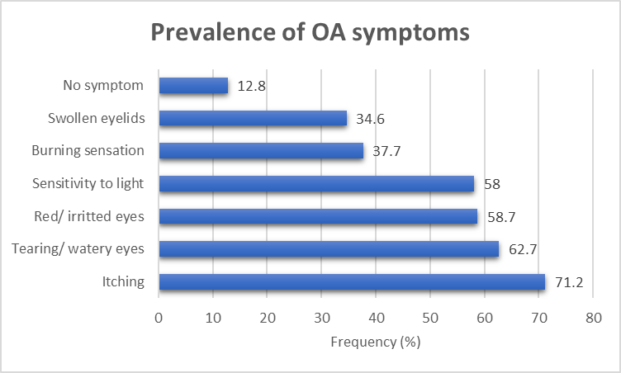
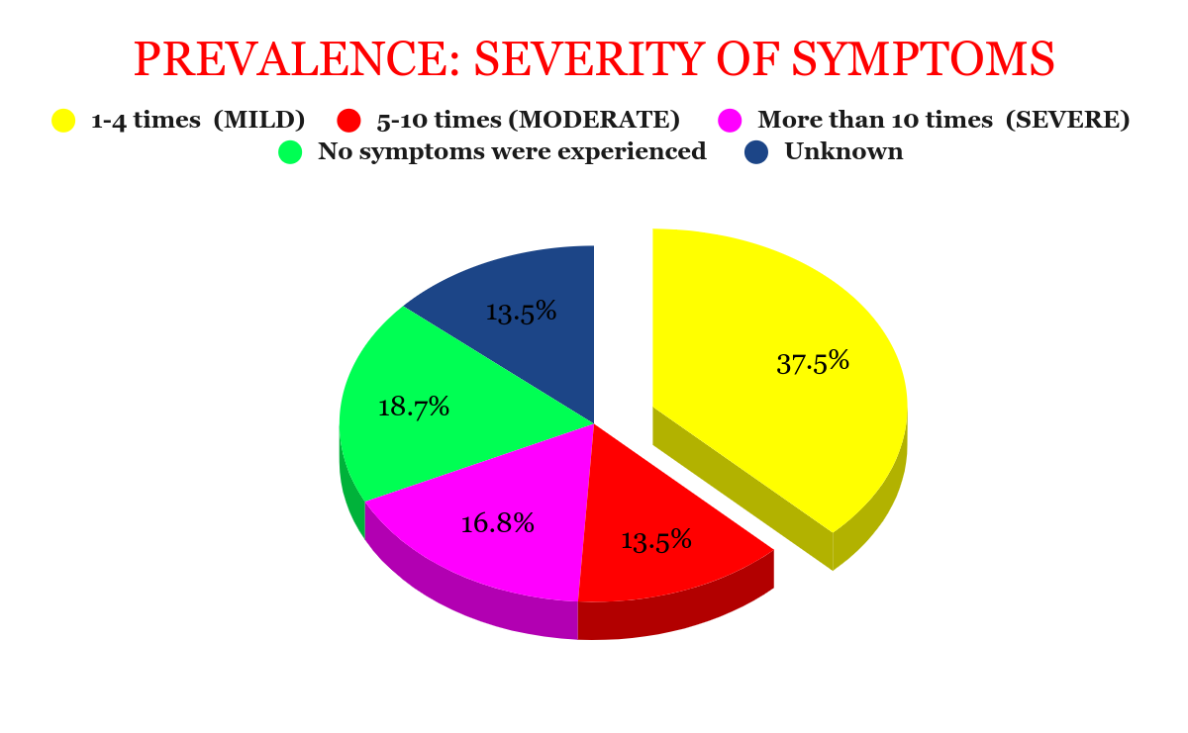
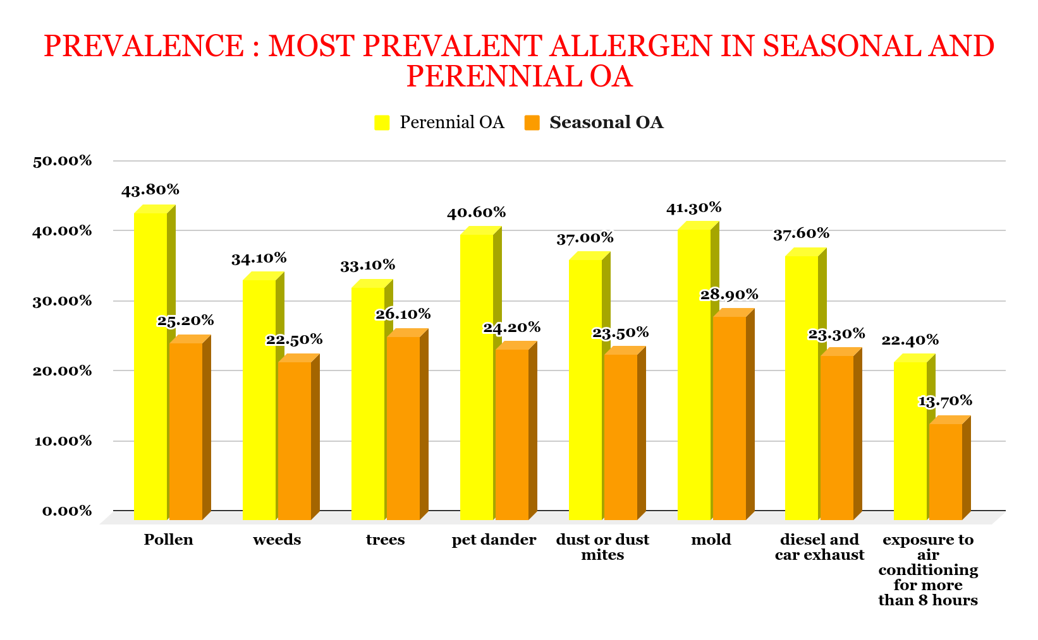
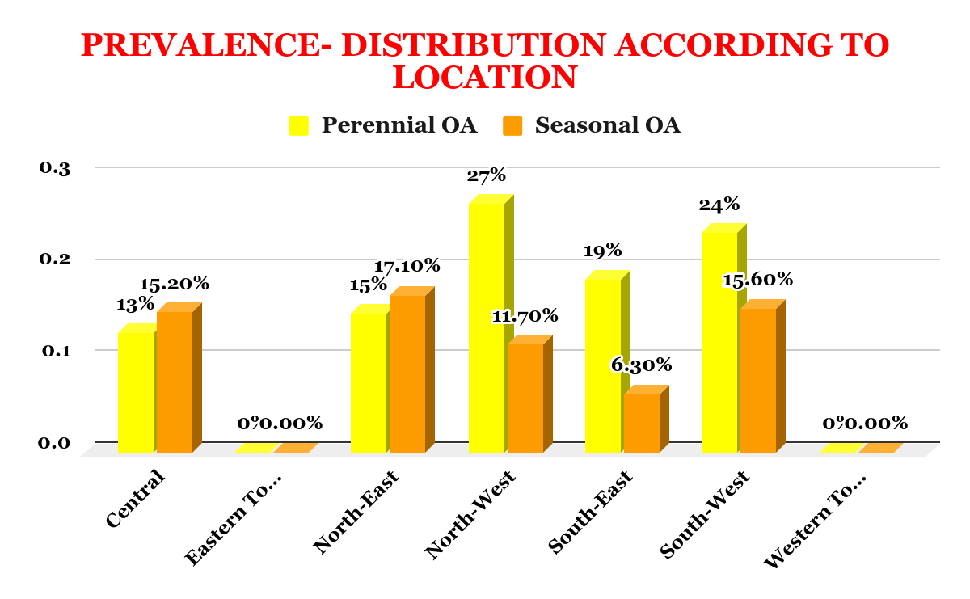
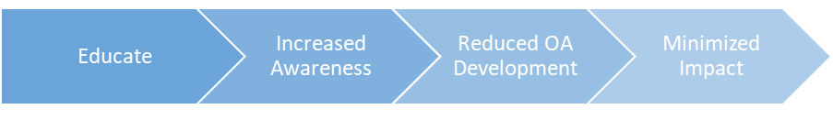
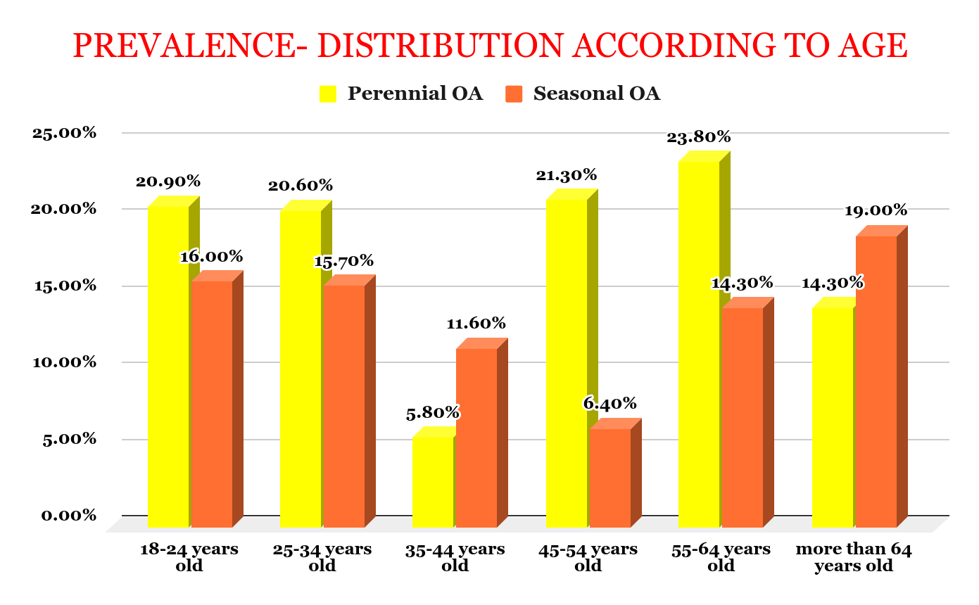
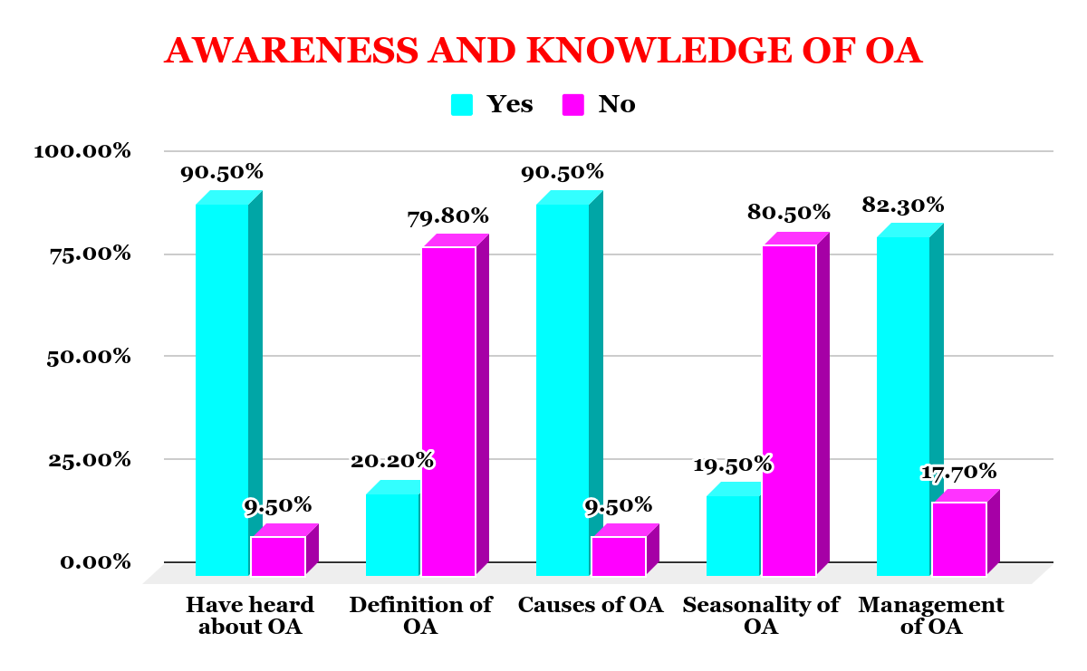
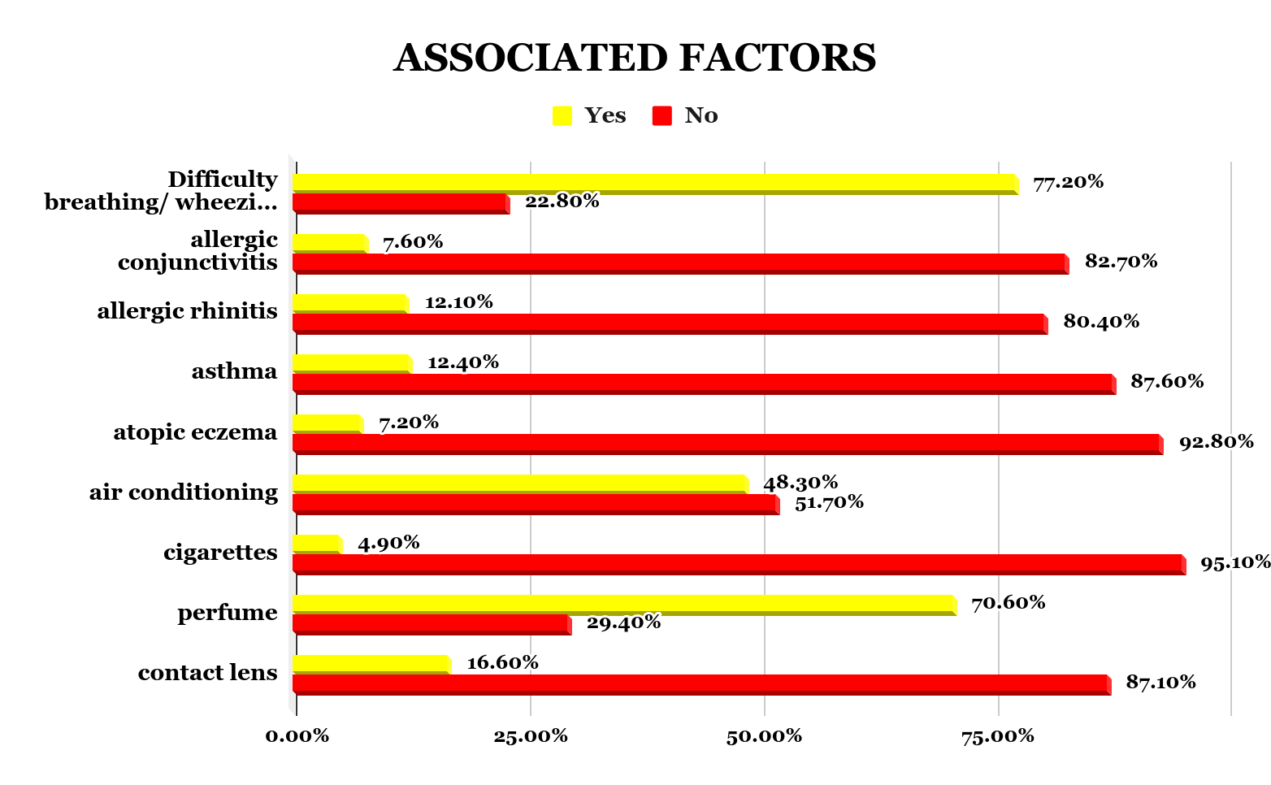
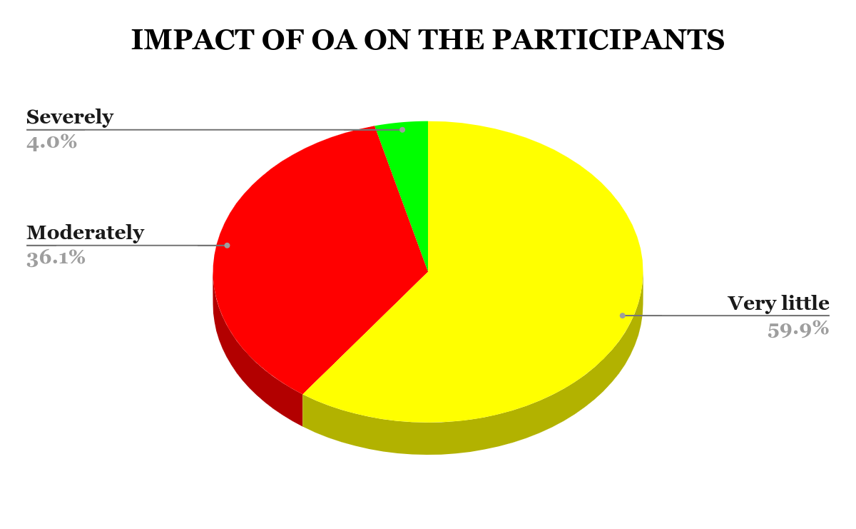
EPIDEMIOLOGY OF OCULAR ALLERGY IN TRINIDAD AND TOBAGO
S. CLARKE, D. CLOPTON, A. COLTRUST, D CONSTANTINE, A. CORDNER, J. COWARD, R. DABIEDEEN, P. DALSOU
¹Deparment of Clinical Surgical Sciences Faculty of Medical Sciences, UWI
e: jolyne.coward@my.uwi.edu ngozika.ezinne@sta.uwi.edu
Introduction
Results
Discussion
The prevalence of OA in Trinidad and Tobago was found to be 87.2% which was significantly higher than findings in Japan (34.8%) and in Brazil (20.7%). This dissimilarity can be attributed to Trinidad and Tobago's tropical climate and high humidity conditions. The country’s heat-stimulated dryness and wind allows for increased pollen air transport, while the moisture from rainy days and relatively high humidity facilitates mould growth both indoors and outdoors. This accounts for the increased prevalence of OA in this study and its most prevalent allergens pollen and mould.
Our study recorded the prevalence of OA to be higher among females than males. The majority of our study participant's symptoms were mild (37.5%) and experienced during February and April, which are usually the driest months in Trinidad and Tobago. This comparable with finding is China which concluded that symptoms are predominantly expressed during months corresponding with pollen season.
Our study found that 79.8% of participants lacked the knowledge on how to correctly define OA but were knowledgeable about the causes (90.5%) and management of OA (82.3%). Social media was carded as the major source of information in this study, uplifting the level of awareness significantly.
Older female participants of Indian ethnicity were found to be highly knowledgeable about OA (75%) than others. Persons who possessed at least a high school education were also highly knowledgeable about OA (82.4%).
Findings of this study showed that OA had a severe impact on 4% of the participants' daily lives in the past twelve months and that difficulty in breathing and exposure to perfume were recorded as the major risk factors
Ocular allergy (OA) is also known as hypersensitivity disorder to normally harmless substances, or an allergic reaction of the eye's surface to allergens in the environment. Globally it is highly prevalent and is non-discriminatory amongst age groups. It might be asymptomatic or produce significant symptoms, including visual loss in extreme cases.
Universally, it has varying manifestations and associating factors which makes it difficult to apply any informational studies in practice, leading to its misdiagnosis and undertreatment. For a disorder that is on a global rise in prevalence, it is alarming that there is little to no research on OA in Trinidad and Tobago, and is yet to be studied in the Caribbean region.
The prevalence of ocular allergy was 87.2 %
Objective
To determine the prevalence and demographic distribution of ocular allergy in Trinidad and Tobago to help evaluate its risk and necessary level of concern.
To ascertain the level of awareness and knowledge of ocular allergy among the Trinidad and Tobago population, to determine its role in development.
To investigate the associated factors and impact of ocular allergy among the Trinidad and Tobago population. These results of this study can be distributed to the public and healthcare system which increases public awareness and assists in control and spread.
Methodology
Conclusion
A descriptive, cross-sectional survey was done using a structured online questionnaire to assess the Epidemiology of OA among the population of Trinidad and Tobago only including participants who resided in urban areas of the country for at least 6 months. A calculated sample size of 915 participants was generated using the Raosoft online calculator and a total of 542 responses were obtained. The 37 question questionnaire was distributed using convenience sampling and utilizing an online self-reported data collection approach due to COVID-19 restrictions. Platforms such as the University of the West Indies, Saint Augustine Campus Marketing social media platform, Facebook, Whatsapp, Twitter, and Instagram were used.
The data collected were analyzed using the Statistical Program for Social Sciences (SPSS). Descriptive statistics were used to analyze the demography and categorical variables. Pearson chi-square was used to assess the association of the variables and a p-value of less than 0.05 was considered statistically significant.
The prevalence of OA was notably high (87.2%) amongst older females of Indian ethnicity. Difficulty breathing (77.2%) and perfume exposure (70.6) were the major risk factors associated with OA. Awareness of OA was high (90.5%) but only few participants possessed good knowledge indicating that effort should be placed in bettering the public’s basic understanding on OA. Although there was a lack of knowledge, only a minor amount of participants(4%) had an impact on their daily activities due to OA.
References
Mashige K. Ocular allergy. Health SA Gesondheid. 2017;22.
Leonardi A, Doan S, Fauquert J, Bozkurt B, Allegri P, Marmouz F et al. Diagnostic tools in ocular allergy. Allergy. 2017;72(10):1485-1498.
Feng, Y., Wang, X., Wang, F., Liu, R., Chen, L., Wu, S., Yang, X., Chen, M., Rao, Y. Q., & Li, J. (2017). The Prevalence of Ocular Allergy and Comorbidities in Chinese School Children in Shanghai. BioMed Research International, 2017, 1–11. https://doi.org/10.1155/2017/7190987

