Slide 1


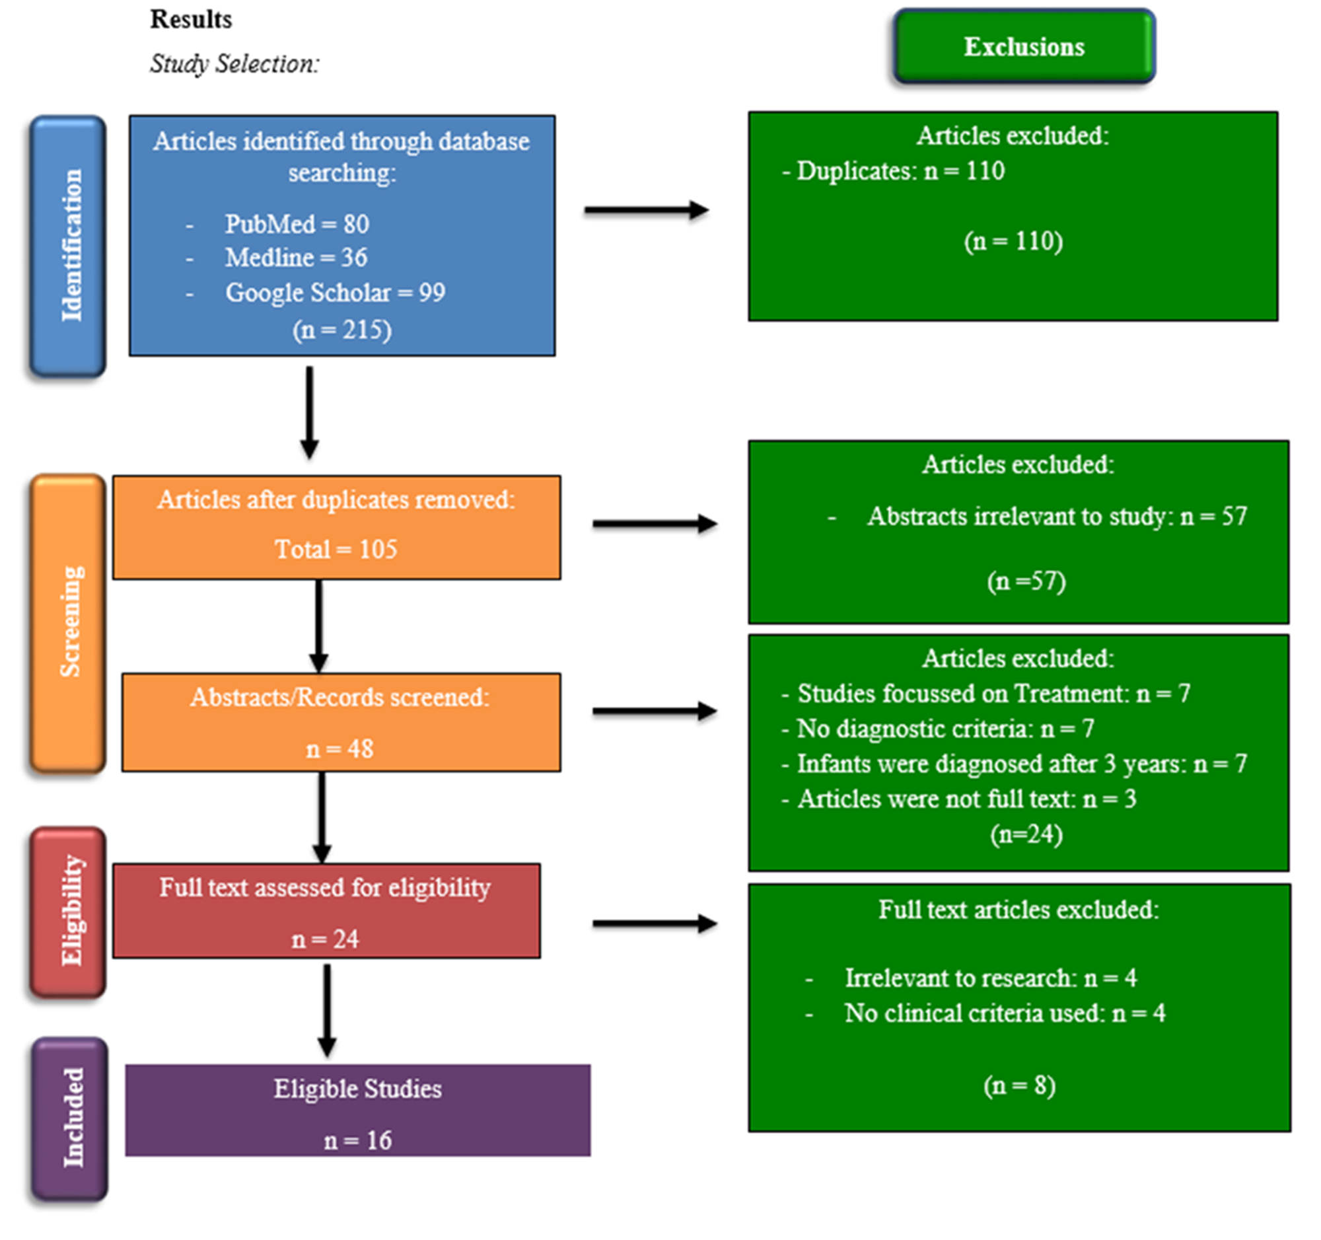
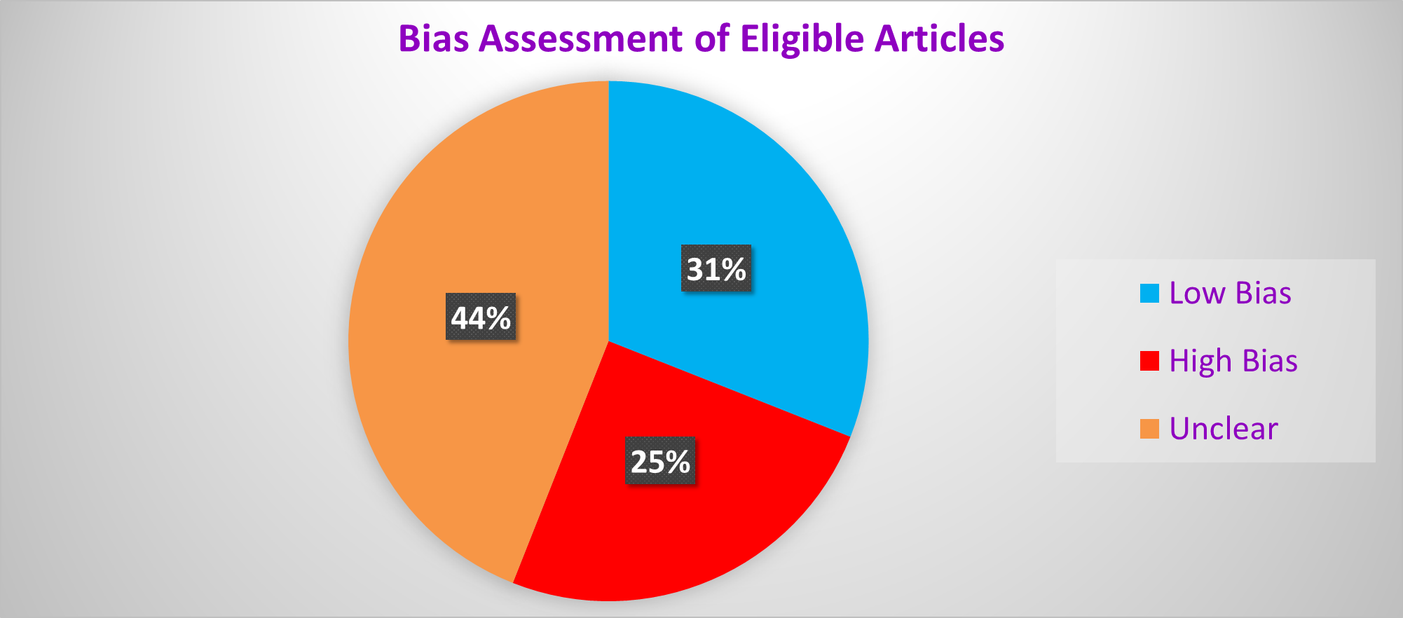
A Systematic Review on the Clinical Diagnosis of Transient Hypogammaglobulinemia of Infants
Nikao P. Davis¹, Candace K. Deonarinesingh¹, Amir A. De Silva¹, Dylan N. Dhanpaul¹, Chloe S. Dookhoo¹, Justin G. D. Doorpat¹,
Alexei L. Dopson¹, Joash M. Durgapersad¹, Angel J. Vaillant¹, Trudee A. Hoyte².
¹Department of Para Clinical Sciences, Faculty of Medical Sciences, The University of the West Indies, St Augustine.
²School of Dentistry, Faculty of Medical Sciences, The University of the West Indies, St Augustine.
amir.desilva@my.uwi.edu, angel.vaillant@my.uwi.edu
Introduction
Results
Discussion
Transient Hypogammaglobulinemia of Infancy (THI) is a primary immunodeficiency disorder caused by the temporary decline of serum levels of immunoglobulin G (IgG) in an infant between 5 and 24 months of age. This immunodeficiency is underdiagnosed as IgG is not routinely measured.
Among the sixteen eligible studies analyzed, the most common criteria used to diagnose THI was IgG, however, it is not the most accurate because there are other disorders that also present with lowered serum IgG immunoglobulins. Multiple studies suggested that THI does not persist after the age of four, therefore, indicating it is a benign condition.
Objective
To systematically review the diagnostic criteria of THI.
To identify gaps in existing literature related to diagnostic criteria of THI.
Conclusion
THI is only definitively diagnosed after the abnormal IgG levels have normalized.
The diagnostic criterion includes vaccine & isohaemagglutinin responses to differentiate against other immunological disorders.
THI is mostly a benign condition but must be monitored for subsequent recurrent infections.
Methodology
Systematic review.
Manual searching of 3 electronic databases (PubMed, Medline, & Google Scholar).
September 2021 – April 2022.
Inclusion criteria – all articles/study types with a clinical criteria/diagnosis of THI in infants (aged 4-36 months.
PRISMA guidelines for reporting of reviews.
Data extraction tool from Cochrane.org.
Bias Assessment tool from Cochrane.org.
Online tool to create figures for bias assessment.
Figure 1: PRISMA Flow Chart showing identification & inclusion process of studies.
References
Vaillant AAJ, Wilson AM. Transient Hypogammaglobulinemia of Infancy. StatPearls Internet [Internet]. 2021 Oct 15 [cited 2021 Sep 29]; Available from: https://www.ncbi.nlm.nih.gov/books/NBK544356/
Ameratunga R, Ahn Y, Steele R, Woon S ‐T. Transient hypogammaglobulinaemia of infancy: many patients recover in adolescence and adulthood. Clin Exp Immunol. 2019 Nov;198(2):224–32.
Moschese V, S Graziani, S, Avanzini MA, Carsetti R, Marconi, M, La Rocca M, et al. A prospective study on children with initial diagnosis of transient hypogammaglobulinemia of infancy: results from the Italian Primary Immunodeficiency Network - PubMed. [cited 2021 Sep 21]; Available from: https://pubmed.ncbi.nlm.nih.gov/18547478/
Wang LJ, Yang YH, Lin YT, Chiang BL. Immunological and clinical features of pediatric patients with primary hypogammaglobulinemia in Taiwan - PubMed. [cited 2022 Mar 29]; Available from: https://pubmed.ncbi.nlm.nih.gov/15366655/
Eroglu FK, Aerts Kaya F, Cagdas D, Özgür TT, Yılmaz T, Tezcan İ, et al. B lymphocyte subsets and outcomes in patients with an initial diagnosis of transient hypogammaglobulinemia of infancy. Scand J Immunol. 2018;88(4):e12709.
Celiksoy MH, Yildiran A. A comparison of B cell subsets in primary immune deficiencies that progress with antibody deficiency and age-matched healthy children. Available from: https://www.elsevier.es/en-revista-allergologia-et-immunopathologia-105-pdf- S0301054616000094
Karaca NE, Aksu G, Gulez N, Yildiz B, Azarsiz E, Kutukculer N. New Laboratory Findings in Turkish Patients with Transient Hypogammaglobulinemia of Infancy. Iran J Allergy Asthma Immunol. 2010;237–43.
Moschese V, Carsetti R, Graziani S, Chini L, Soresina AR, La Rocca M, et al. Memory B-cell subsets as a predictive marker of outcome in hypogammaglobulinemia during infancy. J Allergy Clin Immunol. 2007 Aug;120(2):474–6.
Lougaris V, Soresina A, Meini A, Vettore E, Cattaneo G, Plebani A. Diagnostic criteria of hypogammaglobulinemia in infancy. Hematol Meet Rep Former Haematol Rep [Internet]. 2006 [cited 2022 Apr 13];2(10). Available from: https://www.pagepress.org/journals/index.php/hmr/article/view/446
Ricci G, Piccinno V, Giannetti A, Miniaci A, Specchia F, Masi M. Evolution of Hypogammaglobulinemia in Premature and Full-Term Infants. Int J Immunopathol Pharmacol. 2011 Jul 1;24(3):721–6.
Bukowska-Straková K, Kowalczyk D, Baran J, Siedlar M, Kobylarz K, Zembala M. The B- cell Compartment in the Peripheral Blood of Children With Different Types of Primary Humoral Immunodeficiency. Pediatr Res. 2009 Jul;66(1):28–34.
Habahbeh ZM, Abu-Shukair ME, Almutereen MA, Alzyoud RM, Wahadneh AM. Primary Antibody Deficiencies at Queen Rania Children Hospital in Jordan: Single Center Experience. 2014;10.
Qian J hong;, Chen T xin, Zhu J xing;, Zhu X dong. Clinical features and follow-up of Chinese patients with sym... : Chinese Medical Journal. [cited 2022 Mar 25]; Available from: https://journals.lww.com/cmj/Fulltext/2009/08020/Clinical_features_and_follow_up_of_Chi nese.8.aspx
Kornfeld SJ, Kratz J, Haire RN, Litman GW, Good RA. X-linked agammaglobulinemia presenting as transient hypogammaglobulinemia of infancy. J Allergy Clin Immunol. 1995 Apr;95(4):915–7.
Brignier AC, Mahlaoui N, Reimann C, Picard C, Kracker S, de Vergnes N, et al. Early-onset hypogammaglobulinemia: A survey of 44 patients. J Allergy Clin Immunol. 2015 Oct;136(4):1097-1099.e2.
Lakshman R. Indian Pediatrics - Personal Practice [Internet]. [cited 2022 Mar 25]. Available from: https://www.indianpediatrics.net/aug2001/aug-864-871.htm
Figure 2: Pie Chart showing results of Bias assessment on eligible articles.
Acknowledgments
Special thanks of gratitude to our supervisor, Dr Angel Vaillant, along with Dr Trudee Hoyte for their guidance and support.

