Slide 1

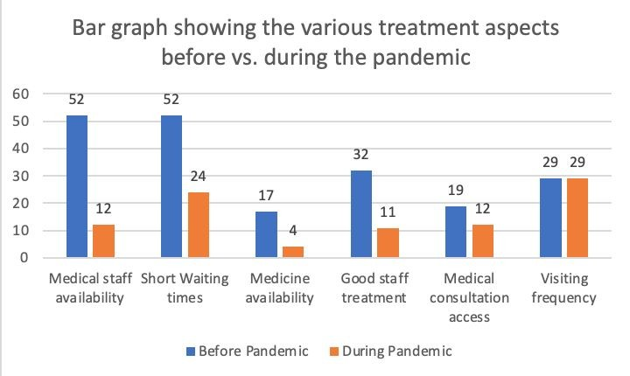
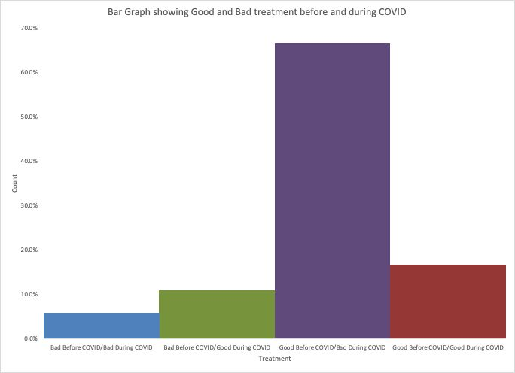
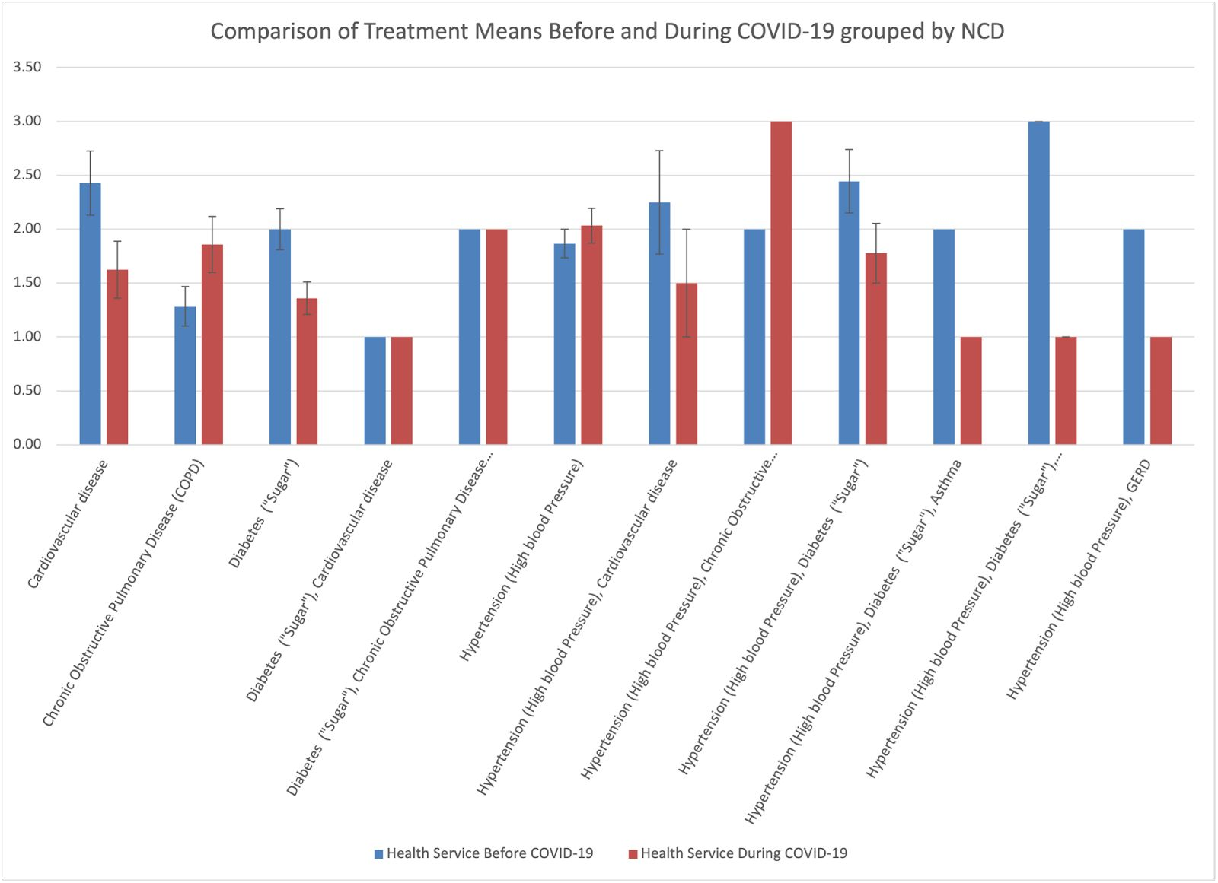
An Investigation into the impact of the
COVID-19 Pandemic on services for patient treatment and care for Non-Communicable Diseases in Trinidad and Tobago.
L.Agostini, D. Aleong, A. Ali, R. Ali, O. Alleyne, W. Antoine, M.Baboolal, V. Baboolal. Dr. Lisa Benjamin.
¹ School of veterinary medicine, Faculty of Medical Sciences, The UWI
e: wendyann.antoine@my.uwi.edu lisa.benjamin@sta.uwi.edu
Results
Introduction
Discussion
NCDs Prevalence
before the COVID-19
Pandemic
Over the last twenty years in Trinidad and Tobago, NCD’s have been the leading causes of deaths, accounting for over 60% of all deaths according to the Pan American Health Organization.
As a result of the COVID-19 Pandemic Restrictions
The prevalence of NCDs in Trinidad is very high, and consistent treatment and care is required for these patients which includes access to health care facilities and medication.
As a result of the COVID-19 Pandemic Restrictions
Data collected showed that 63.4% of the sample depend on public health services for screening, treatment and diagnosis while 12.7% sought out
Broad disruptions to health services due to limited social contact and interactions affecting accessibility and scheduling at health care facilities operated by the five regional health authorities in Trinidad and Tobago.
private care. The majority of respondents, 44.2%, attended public healthcare facilities in the NCRHA. 29.5% of respondents attended public healthcare facilities in the NWRHA.
42.9% of respondents were diagnosed with hypertension, this being the most prevalent non communicable disease, followed by diabetes, comprising 34.8% of respondents. In addition, 33% of respondents were diagnosed with the non communicable disease for five or more years, followed by 29.2% of respondents who were diagnosed 3-4 years ago.
The majority of patients, 82.1%, expressed better treatment before the onset of the pandemic, whereas 17.9% expressed that treatment was not improved. In contrast, 71.3% of patients expressed worse treatment during the pandemic, whereas 28.7% experienced better treatment over the course of the pandemic
Prior to the onset of the pandemic, a majority of respondents, 56.5% respectively, expressed that there were shorter waiting times and better medical staff availability compared to during the pandemic. In addition, other treatment factors such as availability of medications, good staff
treatment and medical consultation access were also increased prior to the onset of the pandemic.
The majority of respondents also expressed a notable overall negative impact on their condition during the pandemic, with 49.1% indicating a negative impact, 20.5% indicating a positive impact and 30.4% indicating
Relevance
to Public Health
This study sought to investigate if the COVID-19 pandemic had impacted patients’ accessibility to services. The results of this study can provide crucial information which can be used to guide the development of strategies to manage non-communicable diseases.
There was the largest decrease in medical staff availability during the COVID-19 pandemic and a general decrease in all treatment services across the board except visiting frequency which stayed the same. There was no increase in any service provided during the pandemic.
Objective
To determine how COVID-19 affected the treatment of persons with NCDs.
To determine how restructuring of the treatment options would have affected patients with NCDs.
To evaluate which group of NCDs is most impacted by the COVID-19 pandemic and if changes in treatment would put individuals with NCDs at a higher risk for contracting COVID-19.
no notable change.
Conclusion
This bar graph shows the public’s experience with COVID-19 before the pandemic vs during the pandemic. It could be seen that treatment was best before COVID-19 and worst during COVID-19
In conclusion, this study found that NCD patients suffering from hypertension belonging to NWRHA and NCRHA experienced the greatest impact on their treatment plans. The study also noted changes in the availability of medical staff resulting in longer than usual waiting times for follow up visits at health facilities. Drug availability to NCD was also negatively during the COVID-19 pandemic.
Methodology
The investigation was conducted as both a retrospective and prospective cross-sectional study
Data was collected from April 8th-22nd 2022 via online questionnaires administered to patients over 18 years, residing in Trinidad & Tobago who had NCDs
The snowball sampling method was used to distribute questionnaires via various NCD associations in T&T.
NCD organizations such as the Diabetes Association of T&T, T&T Cancer Society and T&T Heart Foundation were utilized to source information in conducting the investigation
References
Trinidad and Tobago: Empowering communities to prevent and self-manage noncommunicable diseases (who.int)
Acknowledgments
In this graph , most respondents agreed to having better treatment in most of the communicable diseases had better treatment before the pandemic compared to during the pandemic.
.We would like to thank
Trinidad and Tobago diabetes association
Trinidad and Tobago Non Communicable disease foundation
Members of the public who participated in the questionnaire
Our tutor- Dr. Lisa benjamin

