Slide 1


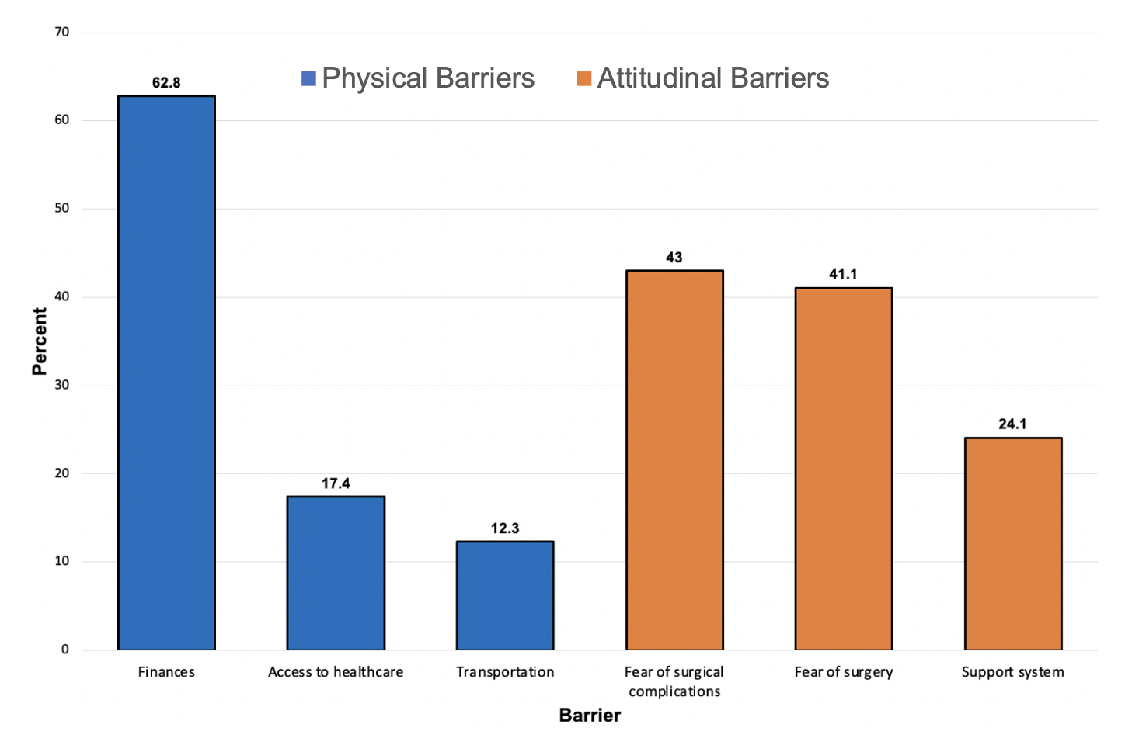
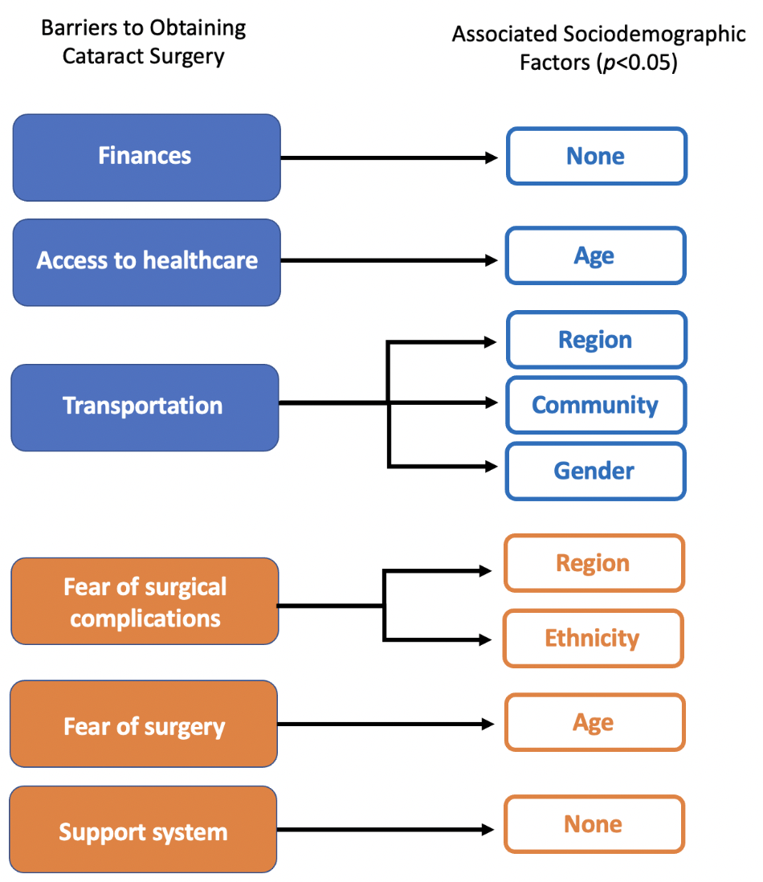
Barriers and Associated Factors Affecting the Uptake of Cataract Surgery Among the Adult Population Age Forty and Over in Trinidad and Tobago
Patrick Campbell, Kayla Carreira, Graham Carvalho, Kirstin Charles, Tiffany Chatoo, Alyssa Chin Aleong, Stefan Choy, Angelina Christopher, Dr. Kingsley K Ekemiri¹
¹Department of Clinical Surgical Science, Faculty of Medical Sciences, The UWI
e: alyssa.chinaleong@my.uwi.edu Kingsley.Ekemiri@sta.uwi.edu
Introduction
Results
Discussion
Untreated cataract worsens over time which can result in severe vision impairment, leading to blindness thereby contributing to the limitations in the overall functioning of an individual.
Cataract extraction can greatly improve one’s vision and by extension quality of life (QoL). However, the uptake of cataract surgery is affected by barriers such as affordability, and poor accessibility and availability.
n = 531; (184 Males, 347 Females)
Prevalence of cataract: 18.1 % (39 Males, 57 Females)
Of all six barriers to obtaining cataract surgery, finances was the most commonly reported (62.8%).
This coincides with the World Health Organisation's World Report on Vision which stated that affordability was the main barrier affecting eye care utilization in T&T.
However, attitudinal barriers were more prevalent compared to physical barriers.
Fear of surgical complications was the most commonly reported attitudinal barrier (43%).
This is consistent with Dhaliwal et al who concluded that, “attitudinal barriers were reported more often, rather than issues of accessibility or cost”, where barriers found in 25-55% of patients included fear of surgery or fear of post-surgical complications.
A significant relationship (p<0.05) was found to exist between the following barriers and sociodemographic factors:
  Access to health care: age
  Transportation: region, community, gender
  Fear of surgical complications: region, ethnicity
  Fear of surgery: age
Figure 1: Bar graph showing the self-perceived barriers to obtaining cataract surgery in T&T.
Objectives
To assess the self-perceived barriers impacting cataract surgery uptake among Trinidad and Tobago’s (T&T’s) population aged ≥ 40.
To examine the association of these barriers in relation to sociodemographic factors, including:
Region resided in T&T
Community (urban/ rural)
Age
Gender
Ethnicity
Figure 2: Associations between barriers to obtaining cataract surgery and sociodemographic factors.
Conclusion
Methodology
Finances was the major barrier identified by the adult population. Notably, attitudinal barriers were more prevalent compared to physical barriers. Considering the consequences untreated cataract poses to one's life, there is an urgent need to eliminate the barriers affecting the uptake of cataract surgery in T&T. Once this is accomplished, individuals affected by this condition are expected to experience an improvement in QoL.
A prospective, cross-sectional study was conducted amongst T&T's adult population aged ≥ 40.
Data was collected using electronic and physical questionnaires.
Convenient sampling was used as 531 responses were collected from the general public.
Data analysis was conducted using SPSS, IBM, version 28.0.1.0. Descriptive statistics and chi-square tests were employed.
References
World Health Organization. World report on vision. World Health Organization; 2019.
The life changing potential of cataract surgery [Internet]. Guardian.co.tt. 2021.
Dhaliwal U, Gupta SK. Barriers to the uptake of cataract surgery in patients presenting to a hospital. Indian J. Ophthalmol. 2007;55(2):133–6.
Ethical Approval: UWI Ethics Committee
(Ref: CREC-SA.1255/11/2021)
Acknowledgments
We would like to thank the Campus Ethics Committee for granting approval to conduct this study, along with our supervisor for his guidance throughout this project.

