Slide 1
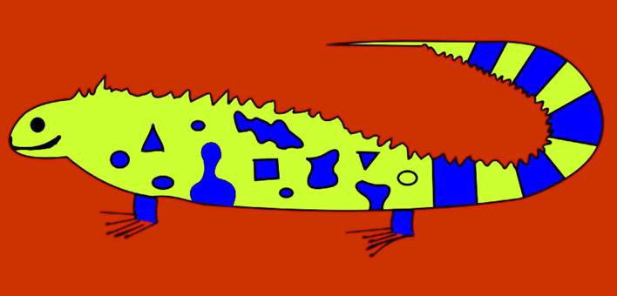
How Iguana Got Her Wrinkles:
Approaches to the Translation of Caribbean Dialect
By Jairo Sánchez Galvis (UWI St. Augustine)

Slide 2
The Tale of How Iguana Got Her Wrinkles, Or The True Tale of El Dorado
Ayeeyosmío! You want me to give you this nasty story? Well you best push up close here beside me so I don't have to talk out too loud. Even though at ninety-six years of age I can't make so much more noise anyway, and worse still since I lost the teeth. Because when the man carried them the other day with me bawling thief! thief! behind him, he only continued climbing through the window smiling he big horsesmile at me with my own teeth in he mouth, and me there with my gums and my lips flapping, and nothing more than the soft thufft! thufft! like a fart coming out my mouth.
Robert Antoni

Slide 3
Goals
1. Key concepts
2. Approaches
3. A way out

Slide 4
1. KEY CONCEPTS
Translatability
Equivalence
Language and dialect

Slide 5
a. Translatability
  “The capacity of some kind of meaning to be transferred from one language to the other without undergoing radical change”. (Pym & Turk 2001, 273)

Slide 6
Absolute Translatability
L1
L2
Universal Language

Slide 7
Untranslatability
World
L1
L2
L3
L4
M1
M2
M4
M5
M3
M6
M2
M4
M1
M5
M3
Notes:
L: LENGUA

Slide 8
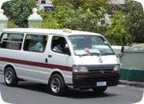
Relative translatability
i think the maxi taxi transportation is a waste of time and needs to be shut down immediately!! it causes to much of traffic and that loud music they be playing is not good!! it is completely nonsense!!i am a university student and takes the maxi taxi every day to go and come but i dread when dat time comes!!its time for trinidad to have a change and be a little more westernized
(Defending the Maxi-Taxi Success http://www.trinidadandtobagonews.com/blog/?p=168)
Clarke is concerned about the behaviour of many of the nation's schoolchildren, their disregard of rules and regulations and a general lack of discipline, problems he believes can be traced to the "ZR Van culture" and to the situation in the home. (“Pride goeth before fall, Bajans warned”, Toni Best. The Nation, http://www.nationnews.com/story/290220117154990.php) January 23, 2007 at 11:26 am )

Slide 9
Relative translatability
An American woman came to Trinidad. When collecting her car from the rental, the clerk said:
-Make sure you stay on the right side of the road.
She replied:
-Which is the left, of course.

Slide 10
b. Equivalence
“the question to be asked in the actual study of translations [...] is not whether the two texts are equivalent (from a certain aspect) but what type of and degree of translation equivalence they reveal.”

Slide 11
b. Equivalence
Interlinguistic
Intertextual
Referential
Connotative
Normative
Textual
Aesthetic
Pragmatic /Dynamic / Functional

Slide 12
c. Language and dialect
The linguistic perspective
LF
L1
L2
LF
L1
L2
LF
L1
L2

Slide 13
c. Language and dialect (2)
The sociolinguistic perspective
L1 (D1)
D2
D3
D4
D5

Slide 14
d. Dialect and Register
User
Dialect
Diatopic (space)
Use (diaphasic)
Register
Temporal (time)
Diastratic (social)
Idiolectal (individual)
Field
Tenor
Modality

Slide 15
e. Norm: Dialect, Standard, Educated Language
Educated Language
Standard
Dialect

Slide 16
2. APPROACHES TO THE TRANSLATION OF DIALECT

Slide 17

Translating dialect
Translating dialect into Standard language.
Translating dialect into Standard language + intratextual commentary.
Translating dialect into existing dialect.
Repetition / Borrowing
Repetition / Borrowing + Extratextual commentary
Register analogy
Omission
Autonomous creation

Slide 18
3. HOW IGUANA GOT HER WRINKLES:
Re-constructing dialect

Slide 19
How Iguana Got Her Wrinkles:
Approaches to the Translation of Caribbean Dialect
By Jairo Sánchez Galvis (UWI St. Augustine)

