Slide 1

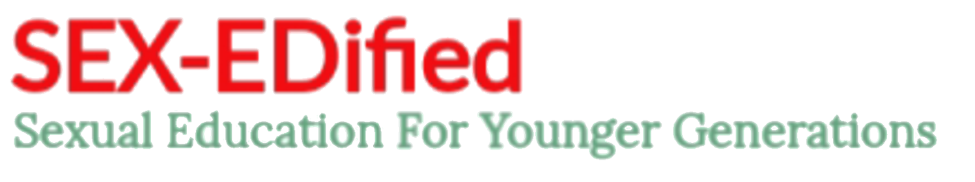
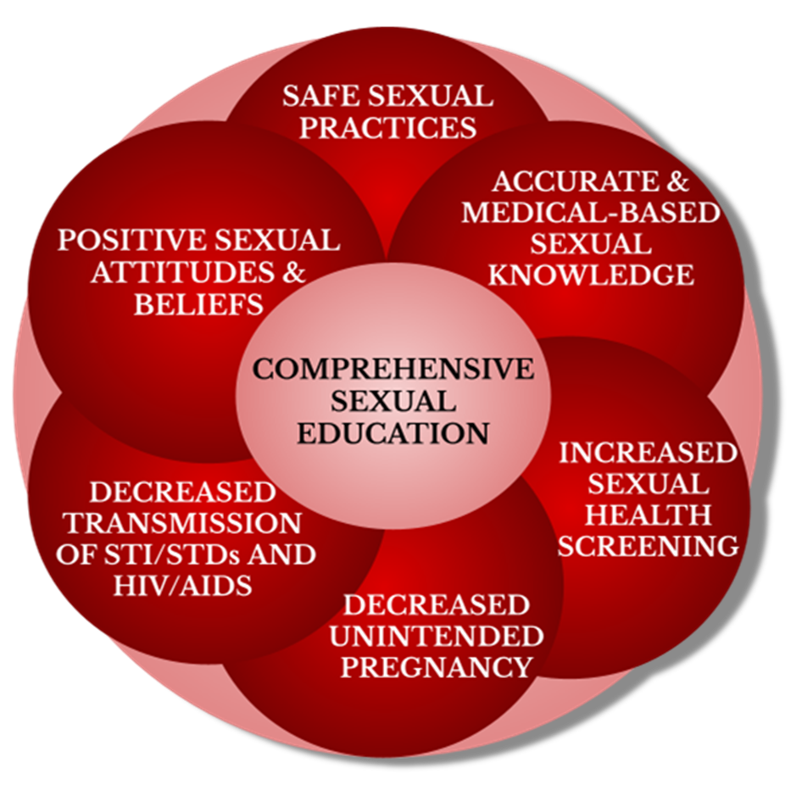
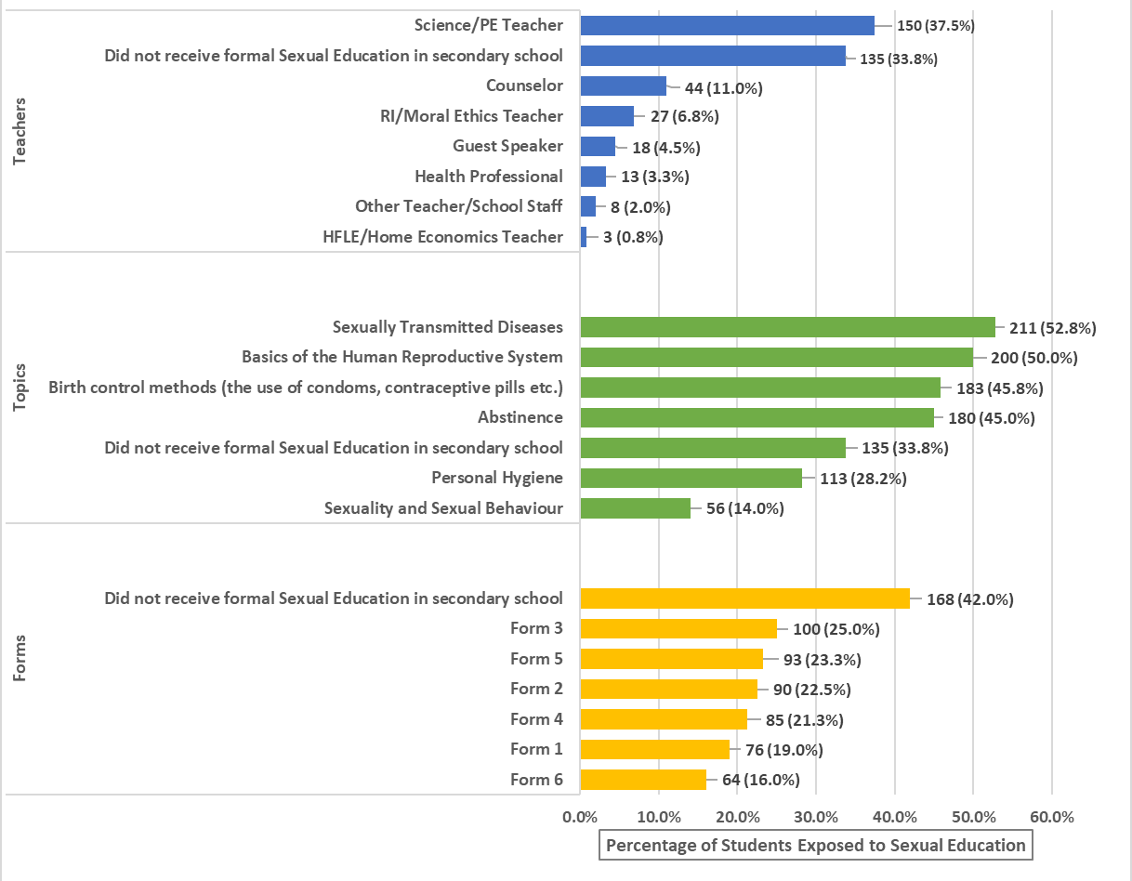
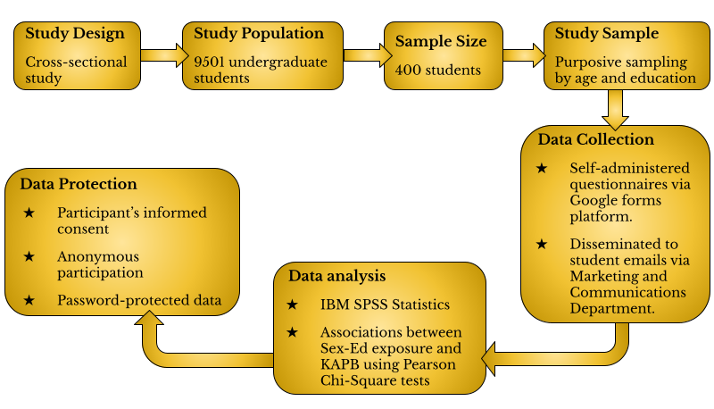
The Knowledge, Attitudes, Perception and Beliefs (KAPB) on Sexual Education and Sexual Practices among Young Adults Attending University in Trinidad and Tobago.
Stephanie Ellis¹, Maryam Emamdee¹, Siddiqa Emamdee¹, Gabrielle Evans¹, Akiela Eversley¹, Oluchi Ezenwaka¹,
Maria Fernandes¹, Jesse Ferrier¹, Satish Jankie², Shamjeet Singh²
¹Department of Para Clinical Sciences, ²School of Pharmacy, Faculty of Medical Sciences, The UWI
e: maria.fernandes@my.uwi.edu ; satish.jankie@sta.uwi.edu
Introduction
Results
Discussion
During secondary school, students
are exposed to Sexual Education
(Sex-Ed) in varying forms. This
can influence future sexual
behaviours and attitudes. This
study investigated the impact
that Sex-Ed programmes had on
the knowledge, attitude, perception
and beliefs (KAPB) of sex-related topics
in T&T among UWI-STA students aged 19-24.
Figure 1: Aspects of Formal Sexual Education Exposure in Secondary Schools in Trinidad and Tobago by Respondents from the UWI-STA.
88.3% of respondents had limited knowledge of Sex-Ed due to the poor delivery of Sex-Ed in secondary school.
The Health and Family Life Education (HFLE) syllabus in secondary school is primarily abstinence-based, leading to limited STD/STI and HIV/AIDS topic coverage by teachers.
Respondents had an above-average grasp of contraception types. However, only 48.0% had knowledge of the best contraceptive methods to prevent unintended pregnancy.
49.5% of respondents who did not receive Sex-Ed corresponded with a negative attitude towards the topics of sexuality and responsible sexual behaviour.
Those with exposure to a level of formal Sex-Ed displayed increased positive attitudes towards the subjects of sexuality and responsible sexual behaviour, but still displayed a lack in accurate knowledge.
Objectives
Measure the extent to which University students aged 19-24 were exposed to Sex-Ed whilst attending secondary schools in Trinidad and Tobago.
Determine the level of knowledge related to sexual practices and sexual health in Trinidad and Tobago among University students aged 19-24.
Determine the APB towards formal Sex-Ed, safe sexual practices and sexual health among University students aged 19-24 in Trinidad and Tobago.
Determine the effect of knowledge on the APB of University students aged 19-24 in Trinidad and Tobago, regarding Sex-Ed.
Participants were aged 19-21 (mean age 20.76±1.295).
50.5% were exposed to formal Sex-Ed in secondary school
88.3% had below basic proficiency in knowledge about Sex-Ed topics.
Significant associations between formal Sex-Ed exposure and contraceptive knowledge were found.
Significant association between formal Sex-Ed exposure and its importance was found (X²(2,400)=13.310, p=0.001).
Attitudes, perceptions, and beliefs (APB) include:
  Sex-Ed should be mandatory in secondary school (79.0%)
  Sex-Ed is important to 60.8% of respondents
  Contraceptive use (76.5%), STI/STD testing (91.5%), and HIV testing (93.5%) were ‘highly important’.
  56.0% of respondents ‘Somewhat’ benefited from Sex-Ed
  65.3% could not agree nor disagree that Sex-Ed promotes the frequency of sex and is ineffective.
Conclusions
There is a lack of knowledge on Sex-Ed and safe sexual practices in young adults due to inadequate provision of Sex-Ed during adolescence, negatively influencing the APB of individuals towards Sex-Ed. This indicates a need for mandatory, comprehensive Sex-Ed in T&T secondary schools.
Methodology
References
Republic of Trinidad and Tobago MOE CPDD. Secondary School Curriculum Forms 1-3 HFLE MOE. (2009). https://uwispace.sta.uwi.edu/dspace/bitstream/handle/2139/39336/Alana%20Gadjadar%20Appendix%20A%20HFLE%20Secondary%20School%20Curriculum.pdf?sequence=2&isAllowed=y.
Republic of Trinidad and Tobago Parliament, JSCSSPA. Fourth Report on an Inquiry into the prevalence of Sexually Transmitted Diseases (STDs) amongst school students and into the general services administered to treat STDs in Trinidad and Tobago. (2018). http://www.ttparliament.org/reports/p11-s3-J-20171117-SSPA-r4.pdf.
Republic of Trinidad and Tobago Parliament, JSCSSPA. Thirteenth Report on an Inquiry into the prevalence of Teenage Pregnancy and the state’s capacity to minimise the occurrence of teenage pregnancy and provide services and assistance to teenage parents. (2020). http://www.ttparliament.org/reports/p11-s5-J-20200306-SSPA-R13.pdf.
Acknowledgements
Special thanks to our supervisors and the student participants who helped develop our research. We extend our gratitude to the UWI Campus Registrar and Ethics committee for granting approval to conduct this study at The UWI-STA.

