Slide 1

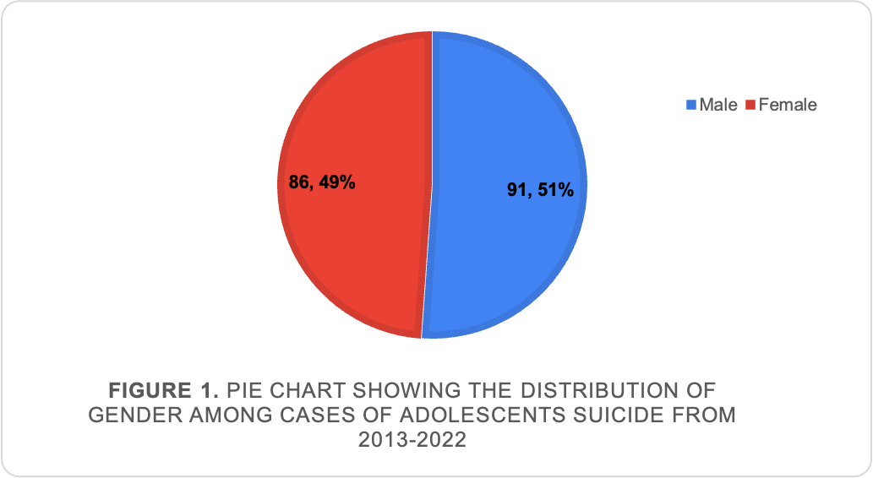
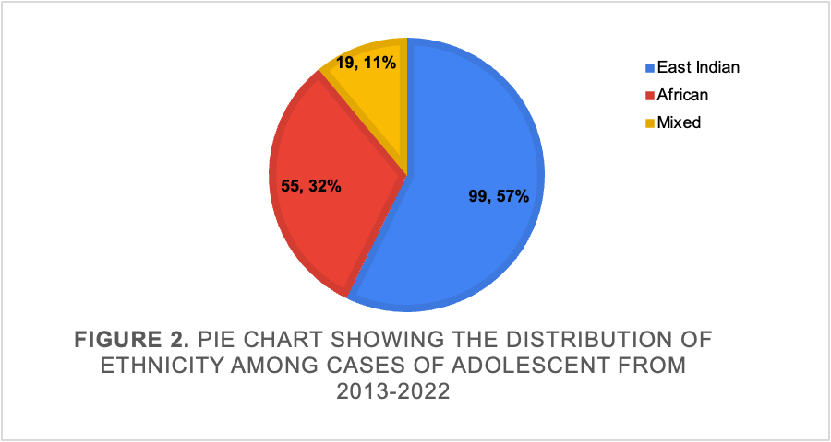
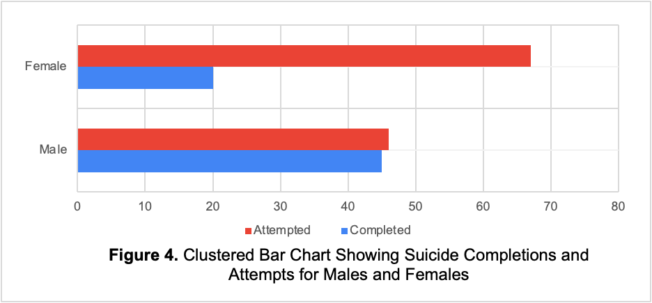
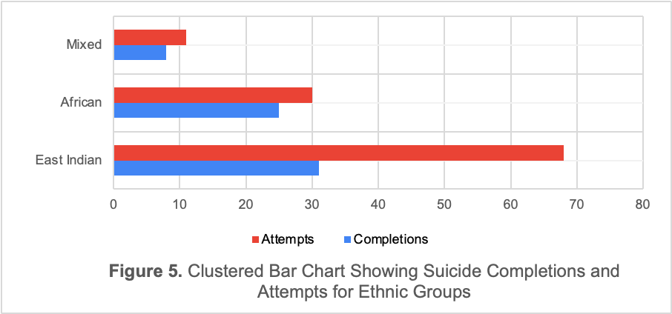
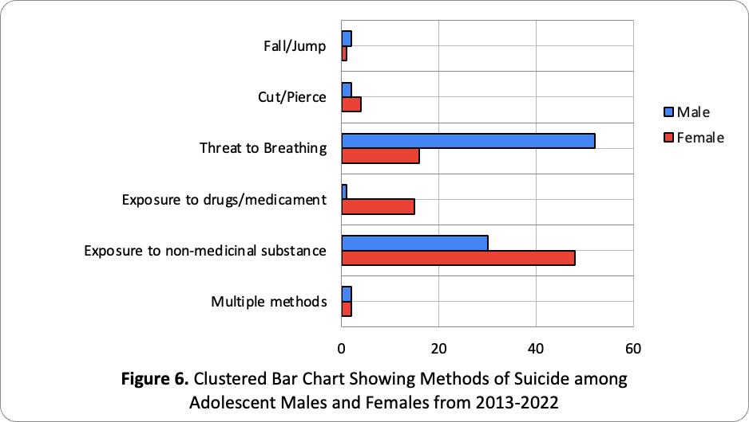
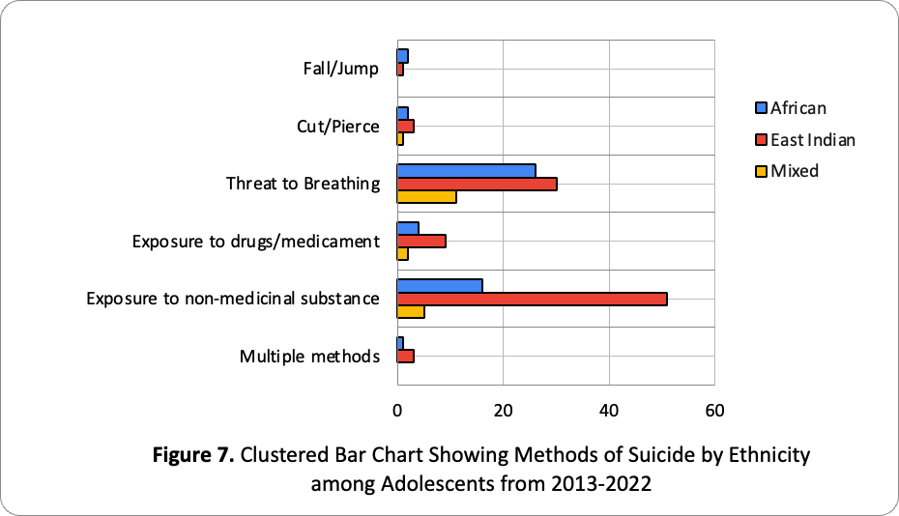
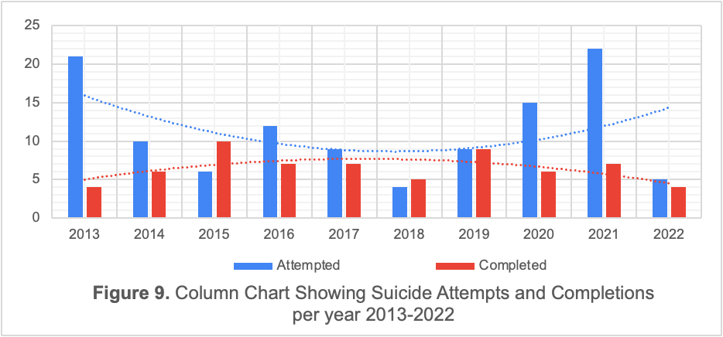
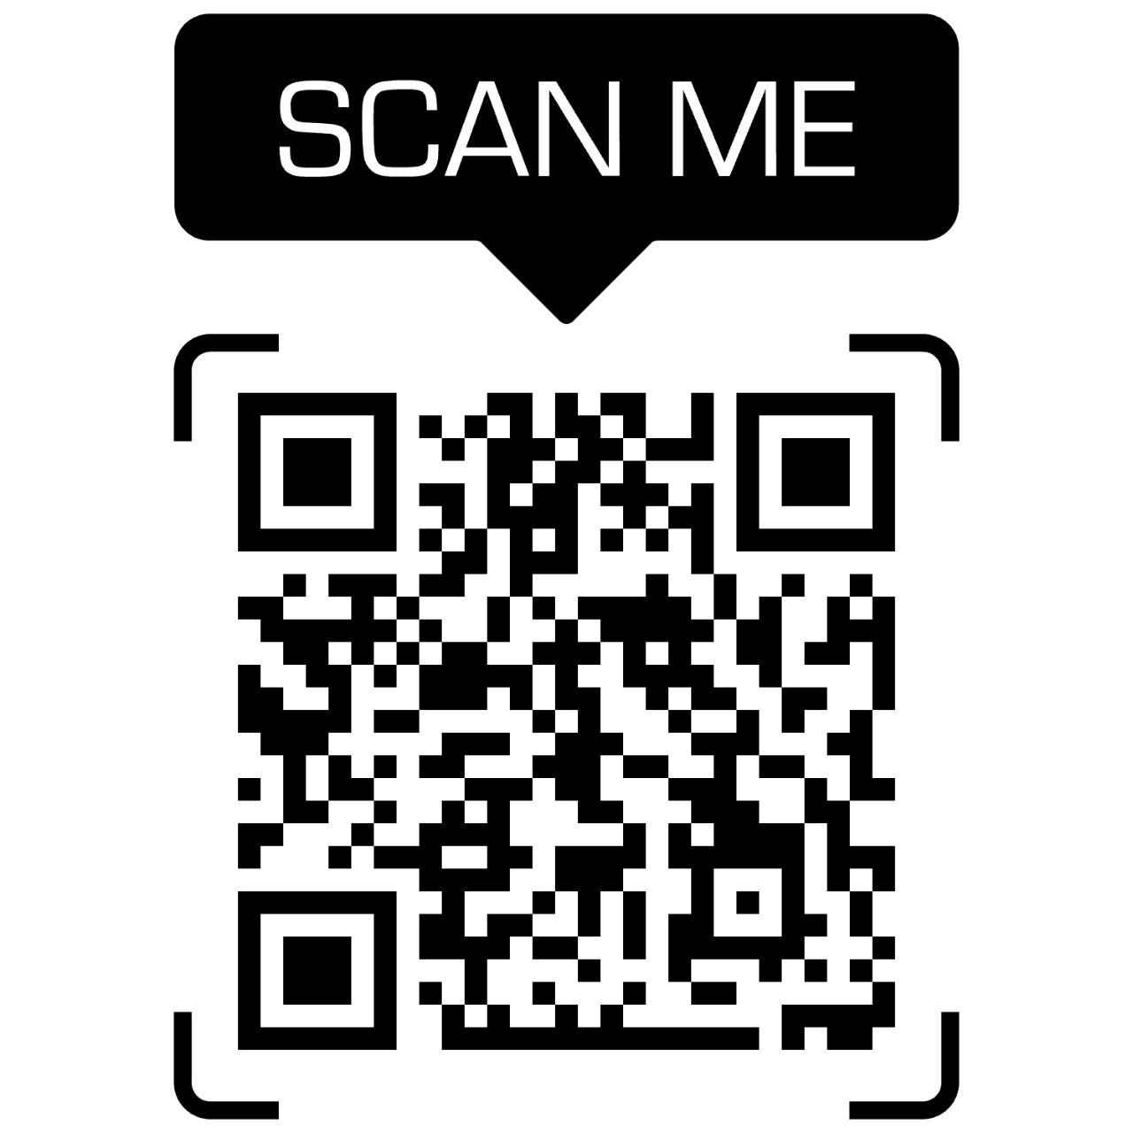
Results
Discussion
January 2013 – January 2022 had 177 reported cases of Adolescent Suicide
Gender: There is a paradox of suicidal behaviour with the number of males is greatly outweighing females in suicide completion; The opposite true for females in relation to suicide attempts.
Ethnicity: East Indian populations have been linked to higher incidences of depressive disorders and therefore suicidal behaviour. African populations follow thereafter with approximately half the cases of suicide attempts and completions as that of East Indians.
Method of Suicide: Completion was more significant by “threats to breathing” while “exposure to non-medicinal substances” was linked to attempted suicides. Suicidal behaviour in young persons is linked to “risk taking” and impulsive behaviour⁽²⁾.
COVID-19 Pandemic: According to the WHO, there has been a 25% increase in anxiety and depressive symptoms, globally, leading to a gradual increase in suicides at the peak of the pandemic.
Gender
Ethnicity
Adolescent Suicide: An Analysis of Gender & Ethnicity Differences in Reported Attempted Suicides, Completed Suicides, and Methods of Suicide in Trinidad & Tobago
Males lead completions while females lead attempts
East Indians lead both completions and attempts
Introduction
“Suicide is a complex phenomenon which can be determined through suicide ideation, suicide attempt and completed suicide” - WHO, 2014⁽¹⁾.
One of the leading causes of death globally with 1 in every 100 deaths carded as suicide.
Due to the taboo nature of suicide, a large percentage of global suicides have been underreported.
For adolescents, suicide is the 4th leading cause of death globally, and the 3rd leading cause of death, locally – PAHO.
“Exposure to non-medicinal substances” is the most common method of suicide among adolescents in T&T
Conclusion
Gender and Method are significant factors in adolescent suicide. Local adolescent suicide also saw a slight increase during the COVID-19 pandemic. Preventative interventions should target the interplay of gender and the methods used, as well as strategies to mitigate the negative impact of the ongoing pandemic.
Prevalence of Suicide Globally and Locally (per 100,000 population)
Worldwide | Trinidad & Tobago
11.4 | 8.3
References
Objectives
1. Preventing Suicide: A global imperative. [cited 2022 May 19]. https://www.who.int/publications-detail-redirect/9789241564779
2. Caribbean Journal of Psychology: Vol. 10, Issue 1, 2018. University of the West Indies Press. [cited 2022 Jun 2]. https://www.uwipress.com/cjp-vol-10-i1-a4/
To determine the effect of gender and ethnicity in completed and attempted suicides in adolescents in T&T.
To compare the method used in completed suicide vs attempted suicides in adolescents in T&T.
37% increase in local adolescent suicides post 2019
Acknowledgements
Methodology
Thank you to Dr. Katija Khan, the Public Health Unit, and UWI Ethics for allowing us to advocate for the nation’s adolescents.
A retrospective study was used to determine the relationship between gender, ethnicity, and methods of completed or attempted suicide in adolescents.
Using secondary data received from CAPA (TTPS), cases were sorted and recoded via the ICD-11 standards for external causes of morbidity or mortality.
IBM SPSS software was used to analyse the sorted data with frequency distributions and Chi Square values produced thereafter.
Jamila Francis, William Furlonge, Rajiv Gangoo, Elizabeth Ganpat, Jelani George, Sachin George, Tonisse George, Ivana Gonzalez Ibrahim; Dr. Katija Khan¹
¹Department of Clinical Medical Sciences, Faculty of Medical Sciences, The UWI
Use cell phone to read full paper
e: jamila.francis1@my.uwi.edu Katija.Khan@sta.uwi.edu

