Slide 1


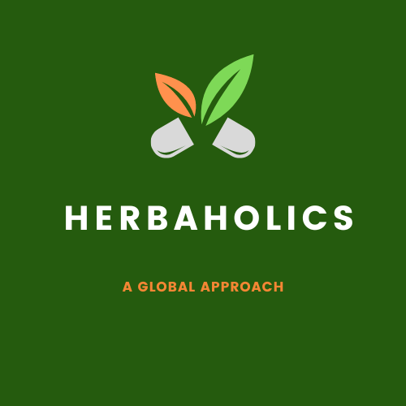
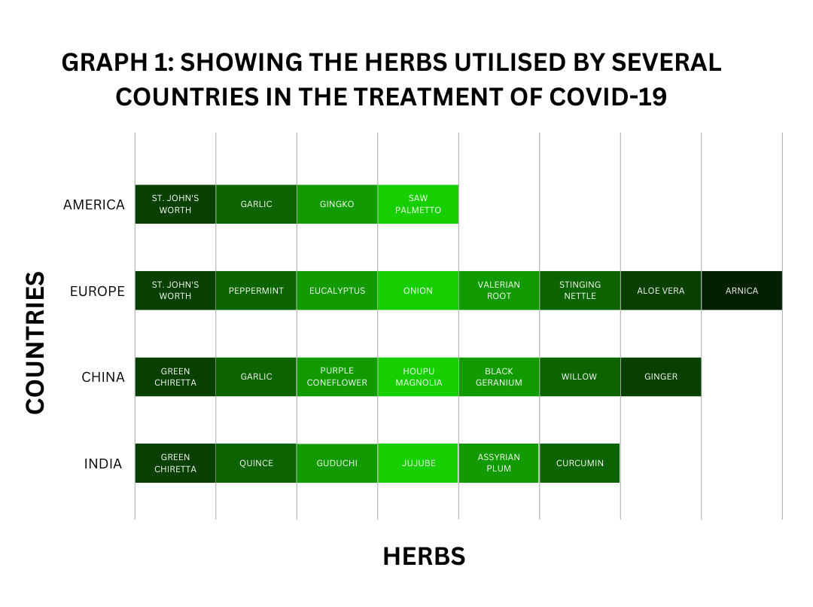
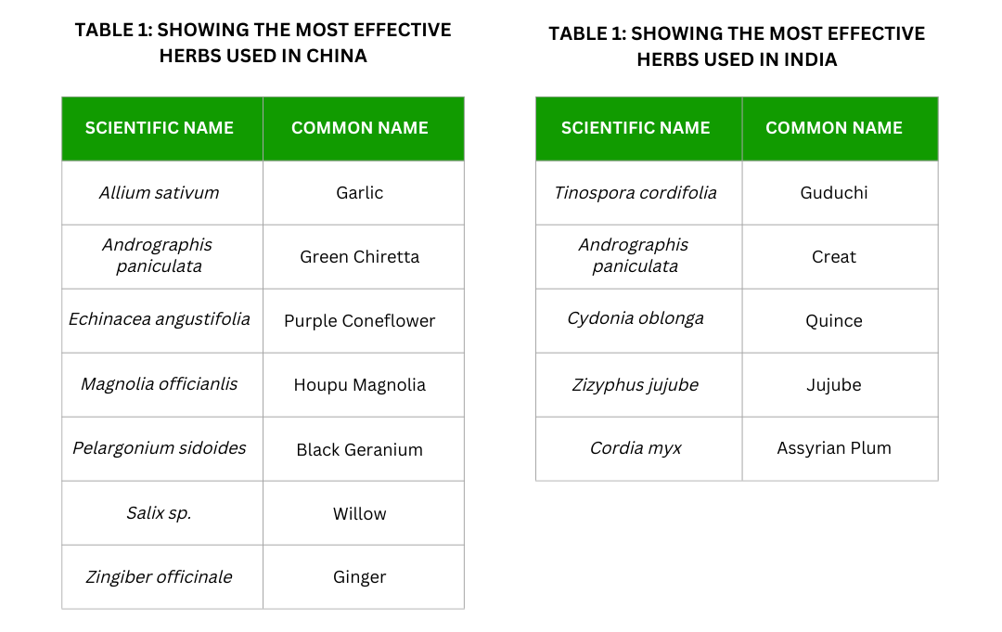
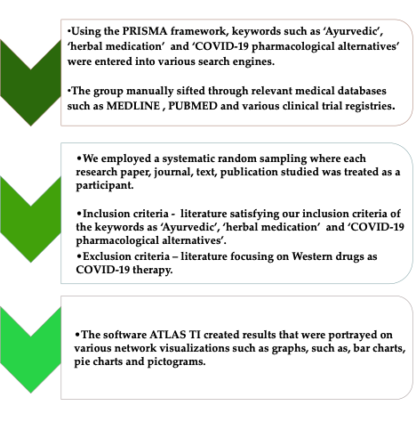
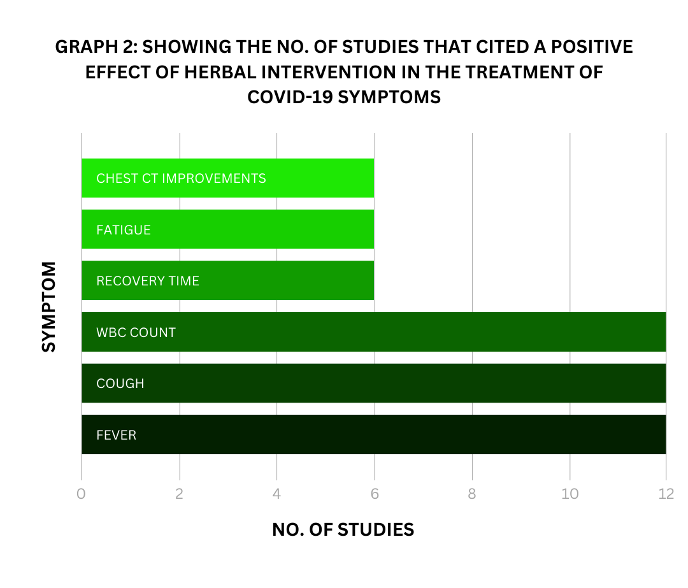
A A SYSTEMATIC REVIEW ON THE USE OF HERBAL MEDICATION USED IN THE COVID-19 PANDEMIC GLOBALLY.
Bradley Beharry, Arlene Bharath, Arun Bissoon, Dexter Blackman, Anderson Boodram, Ashna Buchoon, Amaris Bujhawan, Kashief Campbell, ¹Rajiv Dahiya.
¹School of Pharmacy, Faculty of Medical Sciences, The UWI
e: ashna.buchoon@my.uwi.edu rajiv.dahiya@sta.uwi.edu
INTRODUCTION
RESULTS
DISCUSSION
COVID-19 has impacted the lives of many people around the world with it being declared as a global pandemic in March 2020 and a serious threat to health.
Ayurvedic and Chinese nutraceuticals have been used by people of India and China for thousands of years and is one of the world’s oldest medical applications to date.
According to the University of Texas El Paso or UTP, The use of herbal medication is also heavily involved in the United States, with “About one third of the adult U.S. population medicinal herbs as some form of alternative therapy” .
According to Martins Ekor in a frontiers in pharmacy publication, he discussed that Parts of Europe also use herbal medication to treat various illnesses with impressive figures such as in Belgium and France at 38% and 75%, respectively
These astounding figures show the increasing interest in herbal medications even in countries where Western medicine is prioritized. It is no doubt because of this growing interest that COVID-19 has been approached in many studies from a herbology perspective for treatments and methods of prophylaxis.
India
India has recommended Guduchi (Tinospora cordifolia), Green Chiretta (Andrograhis paniculata) which treats fever, Quince (Cydonia oblonga) which treats sinus symptoms, Jujube (Zizyphus jujube) which aids in nausea and vomiting and Assyrian Plum (Cordia myxa).
Seasame oil (Anu thailam) is used in the form of nasal drops to treat sinus symptoms. Curcumin also has a positive effect on relieving COVID-19 related inflammatory response due to the antiviral activity that curcumin exerts on enveloped viruses (including SARS-CoV-2) through “direct interaction with viral membrane proteins; disruption of the viral envelope; inhibition of viral proteases; induce host antiviral responses.”. Curcumin has also been seen to be safe in most healthy individuals making it an exceptional therapeutic candidate for COVID-19.
China
China, Andrograhis paniculate was also used in treating fever along with Milkvetch (Astragalus mongholicus ) liquorice (Glycyrrhiza glabra L.) and siler (Saposhnikovia divaricate. Purple Coneflower is known to be used in treatment of bronchitis, coughs, the common cold, upper respiratory infections together with Garlic and Ginger, all of which were recommended in China to help fight the virus and reduce the time of hospitalization.
Europe
Europe has also made use of St, John’s Wort, and Ginger in their treatment of COVID-19. They also frequently used peppermint, chamomile, sage, eucalyptus, onion, valerian, stinging nettle, Aloe vera and arnica.
OBJECTIVE
To systematically review the use of herbal medication worldwide against fever, fatigue, cough and other symptoms of COVID-19.
METHODOLOGY
CONCLUSION
Efficient herbal treatments were found to contain phytochemical constituents such as alkaloids, flavonoids, terpenoids, phenols, polyphenols, tannins, saponins, polysaccharides, lipids, proteins and peptides allowing for the management of fever, cough, chest pain, discouraging fatigue and increases the encourages white blood cell count.
These drugs are seen to be those with antipyretic, anti-inflammatory, expectorant, anti-asthmatic, antitussive and antiviral properties which reduce the invasion, penetration, reproduction and expression of the virus.
References
Herbal safety [Internet]. UTEP. [cited 2021Dec20]. Available from: https://www.utep.edu/herbal-safety/top-selling-herbal-products-in-the-us.html
Ekor M. The growing use of herbal medicines: Issues relating to adverse reactions and challenges in monitoring safety [Internet]. Frontiers in pharmacology. Frontiers Media S.A.; 2014 [cited 2021Dec20]. Available from: https://www.ncbi.nlm.nih.gov/pmc/articles/PMC3887317/
RK, Mudnakudu-Nagaraju KK, Shivamallu C, Subramaniam KJT, Radhakrishnan A, Bhojraj S, et al. Antiviral and immunomodulatory activity of curcumin: A case for prophylactic therapy for COVID-19. [Internet]. Heliyon. Elsevier; 2021 [cited 2021Oct13].
Chaachouay N, Douira A, Zidane L. COVID-19, prevention and treatment with herbal medicine in the herbal markets of SaléPrefecture, North-Western Morocco. Eur J Integr Med [Internet]. 2021 [cited 2022 Jun 21];42(101285):101285. Available from: http://dx.doi.org/10.1016/j.eujim.2021.101285
Acknowledgments
We would like to formally acknowledge our supervisor, Dr. Rajiv Dahiya for his assistance in this research study as well as to the Association of Pharmacy Professionals (A.P.P) for the reviews.

