Slide 1
Towards a model of Learning on Online Social Networking Sites!
Vimala Judy Kamalodeen
UWI Biennial Conference April 2013
Notes:
This paper considers a model to describe how teachers can learn in an online educational social network site (SNS). There are three sections to the presentation: discussions about traditional professional development and teacher learning, exploring educational online social networking sites and then a look at relevant theories of learning related to online social networking which will lead up to a model of learning on online SNS.

Slide 2
Why consider a model?
Traditional Learning
Formal Learning Spaces
Existing theories of learning
Notes:
It has been argued that traditional profesional development practices do not adequately meet the needs of today’s teachers and that new models need to be explored for teachers to learn while engaged in practice. How have teachers been prepared for their jobs in schools? How have teachers inservice being educated and what support is there for continuing and ongoing professional learning?
Traditional learning spaces are Schools of Education and training rooms of the MOE and other similar. In these scenarios, teachers select programmes and courses of study- in pedagogy- how to teach. Existing theories of learning such as cognitivism, behaviorism, constructivism etc are taught and hopefully learnt! To be applied to how student learn in the classroom. And so traditional learning occurs face to face, in large and small groups, after school and on weekends and during school vacation. And this is how we have conceptualised teacher training and preparation for eons…
Increasingly, teachers complain that these models are not working. That school after school is too demanding and unrealistic. That they are too alone in their classrooms.
BEd, DipEd, Med etc that classes are too late, too far, library not open after a certain hour etc
And so the attention shifts from teacher training to teacher learning?

Slide 3
Teacher Learning
Workplace learning
Informal learning
ongoing support
Informal interactions
Teacher Professional Development
Discrete activities such as workshops
Standalone
Does not support teachers in classroom
Notes:
The idea that teaching is a learning profession (Darling-Hammond et al., 2009) engages a substantial body of literature and researchers distinguish between the concepts of professional development and professional learning. Recently, newer, more complex and broad-based ways of looking at teachers’ learning have emerged over observations of ‘discrete’ activities like workshops and seminars (Desimone, 2009). These investigations stem from an idea from research that teachers’ participation in professional development workshops do not appear to result in learning. These workshops are stand-alone and are unable to provide ongoing support for teachers as they try new strategies in the classroom, and this may be exacerbated in an uncaring school environment (Dede et al., 2009). Desimone (2009) asserts that the most difficult part of teacher professional development to measure is teacher learning, however, she argues for more appropriate ways of measuring teacher knowledge change and proposes that recent research in the field has allowed a conceptual framework for teacher learning to emerge and should be used without bias. Research on teacher learning includes that of teacher education and professional development and also what is learnt from informal interactions with colleagues and daily classroom practice (Feiman-Nemser, 2008; Vermunt and Endedijk, 2010). Moving from formal settings for professional development to teachers’ informal interactions that take place in a workplace context as teachers engage in their daily practice has spawned researchers to examine how learning can take place in informal settings (Borko, 2004; Opfer and Pedder, 2011).

Slide 4

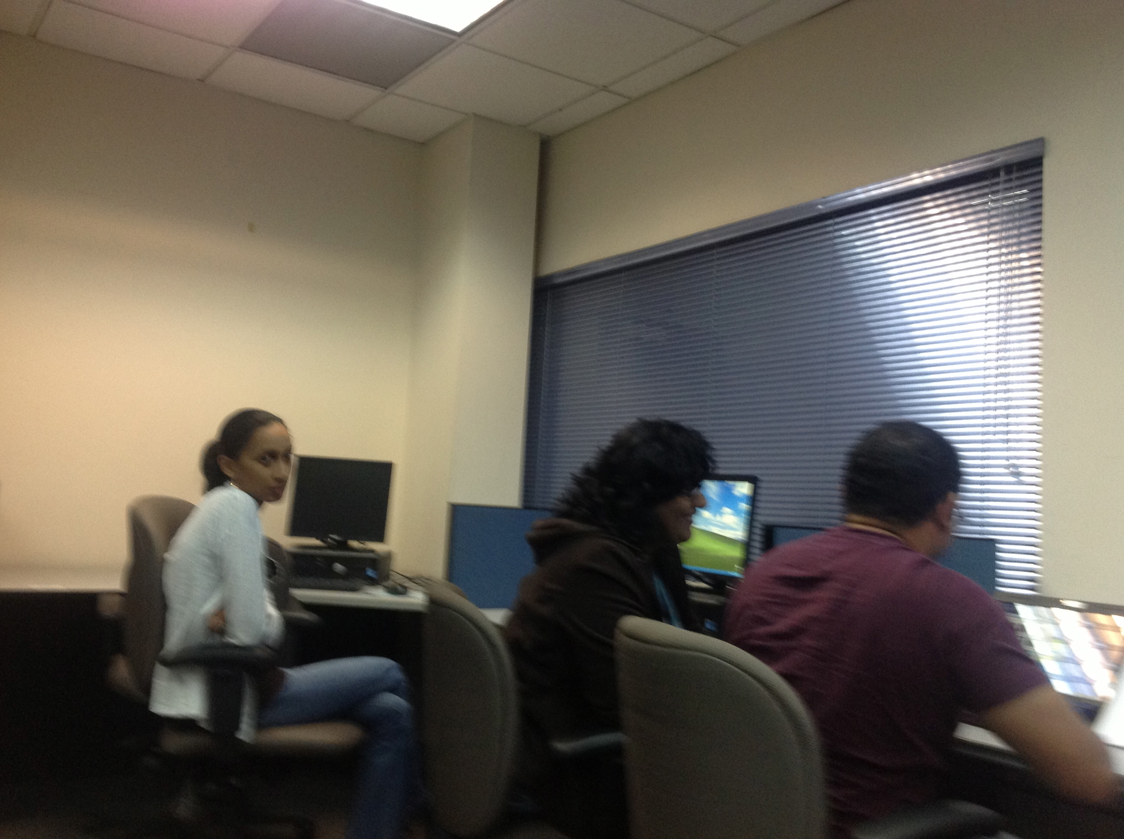
Teacher Learning
“an active process in which teachers engage in activities that lead to a change in knowledge and beliefs (cognition) and/or teaching practices (behaviour)”.
Bakkenes, Vermunt and Wubbels (2010, p. 538)
Notes:
Bruce, Esmonde, Ross, Dookie and Beatty (2010, p.1599), propose that in professional learning, “professionals learn from experience and that learning is ongoing through active engagement in practice”. Research into teacher learning is not as well developed as that of student learning (Vermunt and Endedijk, 2010). Bakkenes, Vermunt and Wubbels (2010, p. 538) adopt a definition of teacher learning as “an active process in which teachers engage in activities that lead to a change in knowledge and beliefs (cognition) and/or teaching practices (behaviour).

Slide 5
Perspectives on Issues that Impact Teacher Learning
Adult learning
Workplace Learning
Informal learning
Experiential learning
Self-Directed Learning
Independent learning
Notes:
Learning theories refer to ideas about how the complex process of learning takes place. These theories have been largely influenced by how children learn, especially in school settings but may be inadequate to describe how teachers learn, both in formal and informal settings.
Focusing on the teacher as a learner also enables me to place a lens on adult learning as teachers are perceived as adult learners. Initial work on understanding adult learning is credited to Knowles who developed the concept of andragogy, which is built on principles of pedagogy applicable to any adult learning situation. Knowles (1990 in Knowles, Holton and Swanson, 2005, p. 57) created a set of assumptions about how adults learn which he used to develop educational programs for adults. The six assumptions of andragogy are that adults are autonomous, self-directed learners, they need to know why they are learning, they bring a wealth of experience to the educational setting, they enter educational settings ready to learn, they are problem- centered in their learning, and they are best motivated by internal factors. Blondy (2007) concludes that Knowles’ work is applicable to online learning environments and that his assumptions can help educators to create a more learner-centred approach to online education.
Another significant theme in adult learning theory is that of self-directed learning which refers to a concept in adults that is characterized by independence of thought and action (Knowles, 1990). Educational debates continue about the level of significance of personal characteristics like self-direction and motivational interest in teachers’ participation in professional learning activities.
Teachers assert that they learn by doing or by trial and error at school and this may be described as informal learning. This is different from what is commonly understood as professional development for teachers and is accompanied with a shift of emphasis to reflection on practice. Much of this learning is experimental (Van Eekelen, Vermunt and Boshuizen, 2006) and experiential (Itin, 1999). Informal learning may be described as “learning where no Professional Development trajectory or learning community has been explicitly organized to foster teacher learning” (Hoekstra and Korthagen, 2011, p. 76). Hence much of a teacher’s professional learning takes place at the workplace informally.

Slide 6
Anatomy of Social Networking Sites in Education
Networks across geography and educational contexts
Enabled privacy
High
degree of customization
Maximizing connectivity and data sharing
Notes:
Social networks have traditionally been associated with young people’s desire to make their social relationships public and visible (Greenhow, Robelia, and Hughes, 2009) but has been transitioning into other areas of life such as education (Roblyer, McDaniel, Webb, Herman and Witty, 2010). Research on students’ use of popular SNS’s like Facebook, Myspace and Twitter have gained momentum in recent years (DeSchryver et al., 2009; FitzGibbon, Oldham and Johnston, 2007; Greenhow, 2007; Young and Kraut, 2011). Newer studies such as that of Chen and Bryer (2012) have focused on exploring faculty’s (in higher education) use of social media for informal learning while others have compared students’ and faculty use of social media (Goodman, 2010; Hew, 2011; Roblyer et al., 2010). In this case, the studies revealed non-surprising results that faculty use is significantly less than that of students. In spite of assertions by researchers such as Anderson (2008); Davies and Merchant (2009); Greenhow, Robelia, and Hughes (2009) and Selwyn (2008) that social networking sites can be explored for use in educational contexts, I have not found a wide body of research on teachers’ use of SNS and social media. SNS’s have been gaining ground in popularity in education and teacher networks such as Global Educators for All, Teachers’ Network and Caribbean Educators Networks provide live models of how SNS can be used to engage teachers across large geographical spaces and educational contexts. These SNS’s are somewhat different to that popular SNS like Facebook and Twitter as they allow high degree of customization. Educational SNS’s like Ning, Elgg, Spruz, Edmodo, Mahara target specific groups such as teachers and students or educators and enable sites’ privacy. This higher degree of customization is favored in education while still maximizing the potential for connectivity and data sharing that SNS are known for (Brady, Holcomb and Smith, 2010). Sometimes referred as the ‘walled garden’ approach to using SNS in education (Smith and Holcomb, 2009), it allows site administration to control the learning environment of an SNS.

Slide 7
Teachers Online Educational networks
Content and Relationships
Teachers
Students
Administration
Teacher Educators
Parents
Stakeholders
Publics
Local vs Foreign?
Notes:
Teachers in Trinidad and Tobago who join these large-scale networks can interact with others from abroad and engage in a number of global issues but they do not adequately allow for conversations about topical issues or provide for local teachers to connect more closely with each other. Further, there is a need for teachers here to engage with and through local contexts, as much of what is shared has to be adapted for local use and interpretation. This builds the case for an indiginenous SNS which caters to teachers of Trinidad and Tobago (and the wider Caribbean) to share and access culturally relevant resources and form local networks for teaching and learning support.
Among the few studies that research the use of SNS for teacher professional development programmes for practicing teachers are the works of Thistleton-Martin and Lewis (2009) which addresses the use of Ning to create an online community of practice for beginning teachers in Australian primary schools and that of McPherson and Castellani (2008) who investigated the use of Ning to facilitate a cross-national project, Global Connections 2008, for pre-service and in-service educators in teacher preparation programs from the United States, Taiwan, China, Japan, and the United Kingdom. In earlier studies, Beam (2002) reported on the success of an Ontario Network of teachers called the Education Network of Ontario that consists of more than 100000 teachers, administrators, trustees and education faculty today. This computer-mediated network offers email and discussion board facilities and affords teachers the opportunity to expand their connections across large geographic spaces where they exchange ideas and learn from one another, thus extending their learning in new ways. In a very new and relevant study in Finland, Aarreniemi-Jokipelto (2011) used a collaborative learning environment using social media in addition to Moodle, a course management system, which focused on vocational teacher formal learning and had the features of formal and informal learning. Teachers had the freedom to choose social media tools and to create desired collaborative learning spaces for small groups. Also, Liu and Miller (2011) describe some success in using a SNS to facilitate continuing online professional development for teachers after graduation from Teacher College by facilitating an online community of learners. Finally, the ongoing design-based research work of Ostashewski and Reid (2010a) is significant as it provides teachers with an opportunity to access Professional Development using a courselet delivered within a social networking site. When comparisons with traditional online learning systems like Moodle are made, Brady, Holcomb and Smith (2010) suggest SNS cater to a greater degree of interaction amongst participants. They assert that this is due to the highly participatory nature of embedded Web 2.0 tools, thus establishing SNS as an enabling environment for teacher professional learning where teachers can exercise control over their learning, allow for the development of social relationships and experience first-hand how to use Web 2.0 tools (Ostashewski, Moisey and Reid, 2011).

Slide 8
Learning Theories
Online Learning
Social learning
Networked Learning
These theories contribute to a model of learning on an SNS!
Notes:
In my next section, I discuss briefly three theories that I feel impact learning on an online SNS- online learning, social learning and networked learning.

Slide 9

Online Learning
Notes:
Online learning, evolved from early concepts of distance education and e-learning, generally referencing learning associated with participation in online courses. The complex individual and social nature of online learning has been well researched and documented in recent years (Conrad, 2009) as well as potential benefits for learners. A key feature of online learning is the distribution of participants and facilitator across space and time, thus allowing participants from diverse backgrounds and competency levels to learn together. A significant advantage to learners is the freedom to participate either in real-time or delayed (Anderson, 2008). Research has shown that fostering a sense of community among online participants has led to greater success and student satisfaction (Anderson, 2006; Brady, Holcomb and Smith, 2010).
So far, the literature on online learning has been contextualized upon the design and delivery of online learning courses for students in higher education but frameworks for understanding online learning in other spaces such as online networks are deficient (Liu and Miller, 2011). Dron (2006, 2007) in Dron and Anderson, 2007, p. 2460) critiqued studies on social software for “lacking distinct theoretical foundations” by drawing on work on Computer-Mediated Communications which emphasize “intentional collaborative practices which fail to recognize the emergent entity formed by the bottom-up, individual interactions of the many”. This gap has led to studies that explore learning in online spaces in different ways. Davies (2006) describes learning in a space enabled by the photo-sharing tool Flickr as a ‘Third Space’ which allowed users in multiple contexts to share new ideas and “bring cultural understandings together with others, where they can be re-examined, used and transformed in the image-making practices of others” (p. 18).
Anderson (2008a, p.48) argues that the online learning environment is a unique cultural context in itself and cites Benedikt (1991) that cyberspace “has a geography, a physics, a nature and a rule of human law”. The loss of physical space leads to the development of an online identity, which is an important perspective in understanding online learning. Online learning spaces can facilitate teachers’ voices, especially for those marginalized in face-to-face settings (Dede, 2007). They can also give learners the benefits of control over time and space through the affordances of combined asynchronous and synchronous tools. These learning spaces can enable learning in self-directed ways and allows the learner to select content of choice.

Slide 10

Social Learning
Notes:
Social Learning theory (Bandura, 1977) is often seen as a bridge between behaviorist and cognitivist theories because it explains human behavior between cognitive, behavioral and environmental influences. Social learning theory proposed that individuals learn by observing the actions of others and the consequences of those actions, and by imitating behaviours that appear to generate positive outcomes. Theories of social development which promote social interaction for learning and Lave and Wenger’s (1991) situated learning theories are important for examination of how teachers can learn both in and out of school in informal spaces such as in school corridors, lunch rooms and even at home. Vygotsky’s (1978) ‘zone of proximal development’ helps to explain that learning takes place at work in formal and informal settings by novices observing more advanced learners and can apply that to practice almost immediately Researchers like Dede (2005) have looked at the way that learning can be changed in spaces that embed emerging technologies. He acknowledges that situated learning has not been fully utilized in educational settings as much as behaviorism or cognitivism has, because “creating tacit relatively unstructured learning in complex real-world settings is difficult” (Dede, 2005, p. 15.4). The role of knowledge transfer in situated learning is critical and knowledge-sharing and learning is intertwined in the context in which they occur. The epistemology underlying situated cognition is that learning entails the process of doing (Boyle, 2008) so learning takes place by interactions not just with content but also with other people in real or ‘authentic’ situations. Authentic activities are the focus of situated cognition theory, which may be described as “activities that are similar to what practioners do” (Brown et. al, 1989 in Putnam and Borko, 2000, p.4). There are three conceptual themes are central to the situative perspective: cognition that is situated, social and distributed, all of which provide suitable lens for further exploration of teacher learning (Putnam and Borko, 2000).

Slide 11

Networked Learning
Notes:
Newer influences on Lave and Wenger’s social theory of learning are emerging for online teacher professional development. Mackey and Evans (2011) reveal a tension in describing teachers’ dual participation in professional (school) and online communities (from participation in an online course) and extend Wenger’s social learning theory in a bid to understand the intersections of teachers’ informal learning with formal online learning opportunities, and authentic learning in communities of practice. They propose the use of connectivist theory as enabled by e-learning and virtual learning environments, as examples of connectivist pedagogies in action as a more suitable lens to view how teachers, as working professionals, connect with their peers in other schools as well as in their own Their research on teacher online professional development supports Siemens (2005) connectivist theory where
“Personal knowledge is comprised of a network, which feeds into organizations and institutions, which in turn feed back into the network, and then continue to provide learning to [the] individual. This cycle of knowledge development (personal to network to organization) allows learners to remain current in their field through the connections they have formed” (Mackey and Evans, 2011, p. 12).
This network of connections enables interactions among participants and can lead to learning (Dron and Anderson, 2007; Boyd and Ellison, 2007). Studies on network-mediated collaborative learning suggest another approach to learning on SNS (Harasim, 1999). As interest in technology-mediated professional development grows, models emerge to meet the needs of teacher learners with a view to design programmes that are “intensive, ongoing, and connected to practice” (Darling-Hammond et al., 2009, p.10). Lieberman and Mace (2010) discuss the potential of networked technologies and communities to make teaching practice public and the transformative power of sharing teachers’ knowledge. They highlight the value and impact of online connections and claim, “from more formal networks designed with particular purposes to informal grassroots connections, teacher professional learning is thriving online” (p. 86). Networked interactions allow teachers to share their own practice, rather than being the passive recipients of expert knowledge; such interactions provide opportunities for useful discourse related to practice.

Slide 12
Perspectives on Issues that Impact Teacher Learning
SNS Learning
Online
Social
Networked
Active
Authentic
interactive
Flexible in time and space
Constructed
Web 2.0 tools affordances
Distributed
Connected
collaborative
Notes:
Having looked at the literature on teacher learning and on online and social lerning theories, I now apply these theories to learning on an online social networking space. I describe a set of characteristics that are drawn from online learning, social learning and networked learning to construct a model which can describe learning in an online social networking space.

Slide 13

A Model of Learning on SNS
Learning can occur regardless of the geographic location of participants- work or home or other spaces
Learning is flexible across time allowing for delayed responses by participants
Learning can occur through the affordances of embedded asynchronous and synchronous Web 2.0 tools
Learning occurs through interactions with others
Learning is relevant to the learner and situated in authentic (teaching) practices
Learning is constructed through active participation in designed activities
Learning is distributed/shared across the network, available to all participants and public to interested/selected audiences
Learning is enabled through networks of connections created by users
Learning is enhanced by collaboration in activities such as co-creating, co-construction, co-authoring and sharing with others
Notes:
Learning can occur regardless of the geographic location of participants- work or home or other spaces
Learning is flexible across time allowing for delayed responses by participants
Learning can occur through the affordances of embedded asynchronous and synchronous Web 2.0 tools
Learning occurs through interactions with others
Learning is relevant to the learner and situated in authentic (teaching) practices
Learning is constructed through active participation in designed activities
Learning is distributed/shared across the network, available to all participants and public to interested/selected audiences
Learning is enabled through networks of connections created by users
Learning is enhanced by collaboration in activities such as co-creating, co-construction, co-authoring and sharing with others

Slide 14
Next stages:
Examining Teacher Learning on a Designed Educational SNS

